Slide 1
Natural and Cultural Heritage as a Common Denominator of Integration and Sustainability in the EU
By Dr.
MENSAH C. Marius
Assistant Professor
Faculty of Law- University of Maribor
Cocou.mensah@um.si
2023

Slide 2
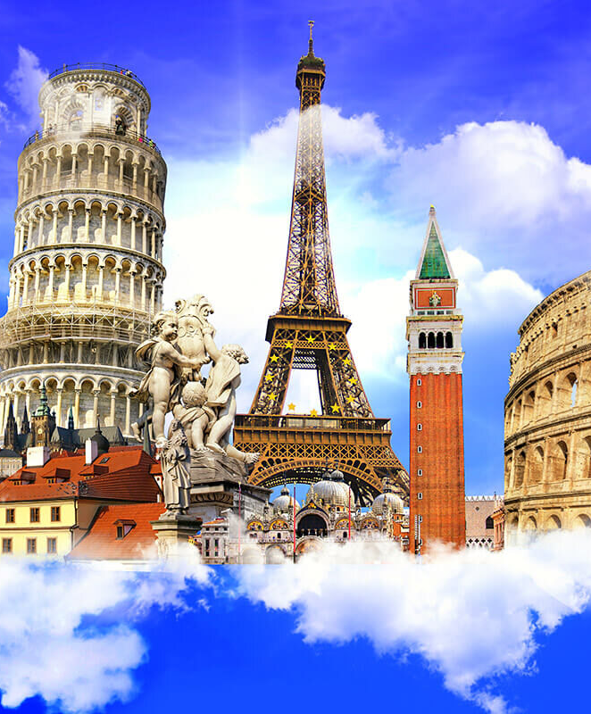
HERITAGE
Heritage is our legacy from the past, what we live with today, and what we pass on to future generations. Our cultural and natural heritage are both irreplaceable sources of life and inspiration. The United Nations Educational, Scientific and Cultural Organization (UNESCO) seeks to encourage the identification, protection and preservation of cultural and natural heritage around the world considered to be of outstanding value to humanity.

Slide 3
Eurostat reported that in 2021, the tourism, natural, and cultural heritage sectors contributed around €756 billion to the European Union, which accounts for approximately 4.9 of the EU’s GDP
This reinforces the EU’s economy and employment rate

Slide 4
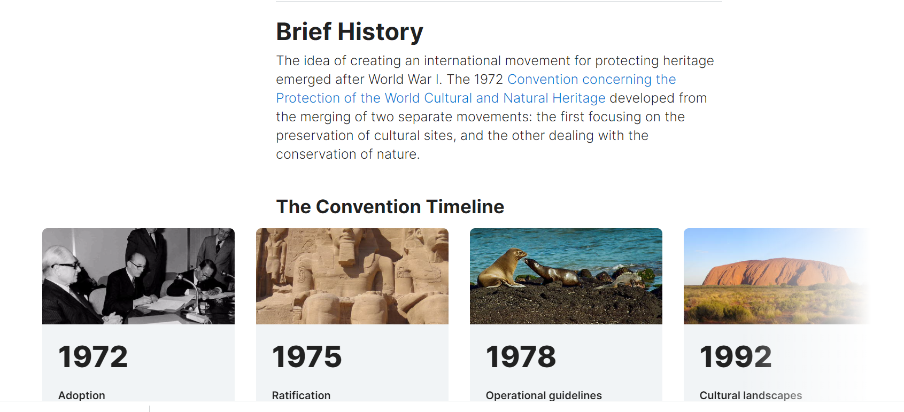

Slide 5
Preserving cultural heritage
The event that aroused particular international concern was the decision to build the Aswan High Dam in Egypt, which would have flooded the valley containing the Abu Simbel temples , a treasure of ancient Egyptian civilization. In 1959, after an appeal from the governments of Egypt and Sudan, UNESCO launched an international safeguarding campaign. Archaeological research in the areas to be flooded was accelerated. Above all, the Abu Simbel and Philae temples were dismantled, moved to dry ground and reassembled.

Slide 6
The campaign cost about US$80 million, half of which was donated by some 50 countries, showing the importance of solidarity and nations' shared responsibility in conserving outstanding cultural sites. Its success led to other safeguarding campaigns, such as saving Venice and its Lagoon (Italy) and the Archaeological Ruins at Moenjodaro (Pakistan) , and restoring the Borobodur Temple Compounds (Indonesia).
Consequently, UNESCO initiated, with the help of the International Council on Monuments and Sites (ICOMOS), the preparation of a draft convention on the protection of cultural heritage.

Slide 7
This is embodied in an international treaty called the Convention concerning the Protection of the World Cultural and Natural Heritage, adopted by UNESCO in 1972.
What makes the concept of World Heritage exceptional is its universal application. World Heritage sites belong to all the peoples of the world, irrespective of the territory on which they are located.

Slide 8
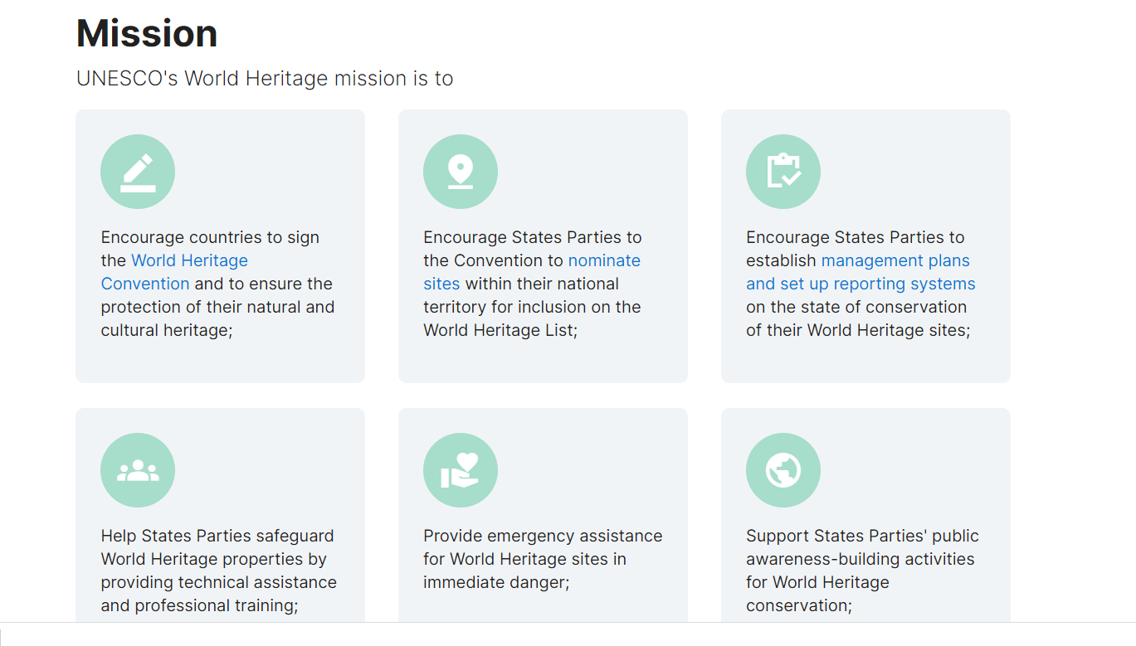
UNESCO- MISSION

Slide 9
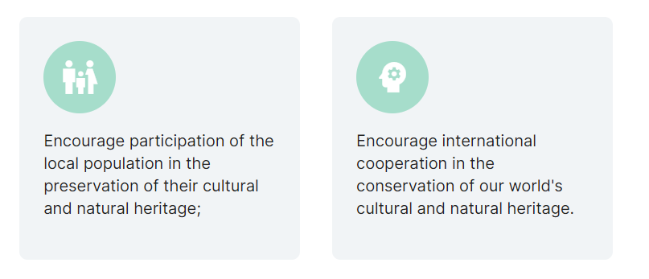

Slide 10
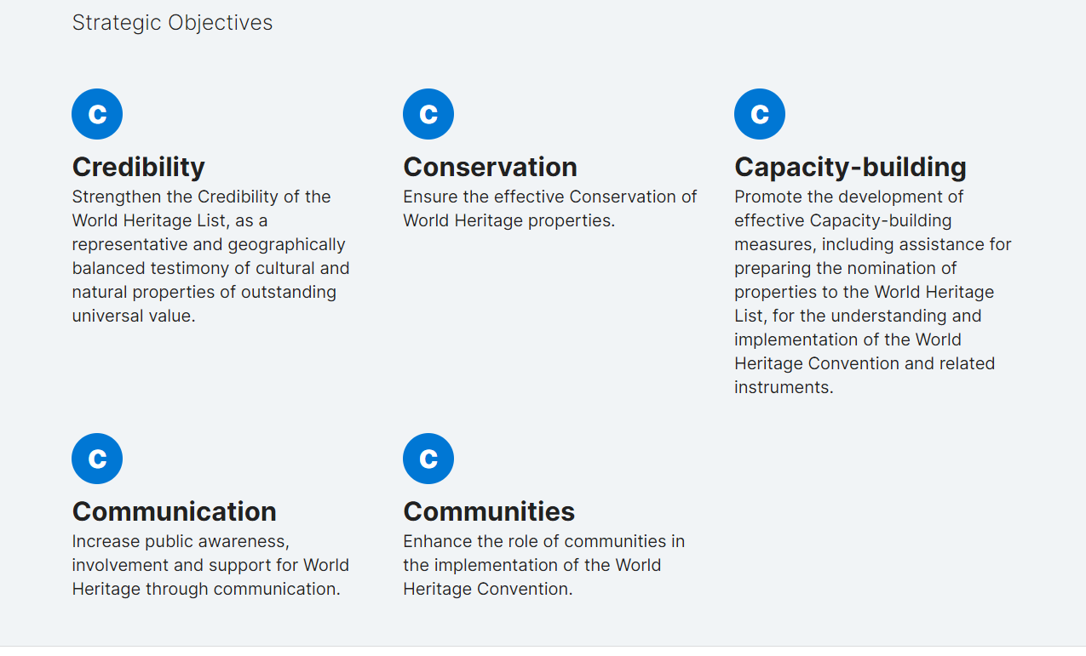
Strategic Objectives

Slide 11
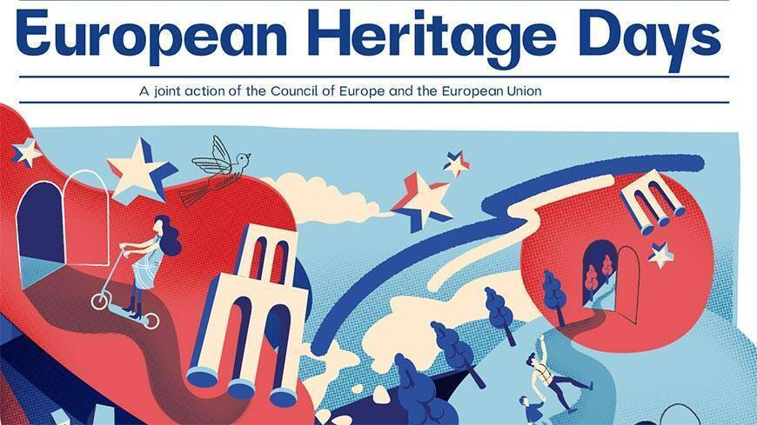
Saturday, September 9- Sunday, September 17
The EU recognizes the importance of preserving and promoting its diverse natural and cultural heritage as a means to foster unity, cooperation, and sustainable development among its member states.

Slide 12

The European Heritage Days represent the most extensively commemorated cultural event in Europe that encourages active participation among its people. Initiated by the Council of Europe in 1985, the program gained the involvement of the European Union in 1999, and it has persisted ever since. Remarkably, this joint initiative attracts an impressive annual visitor count of up to 20 million, making it the most economically impactful cultural undertaking in Europe when considering the value generated for every Euro invested.

Slide 13

Young European #HeritageMakers
The Young European Heritage Makers is a contest designed for the youth of Europe, offering them a platform to delve into their surroundings, discover the most captivating aspects of their heritage, and showcase them to a global audience. This competition aims to inspire young individuals to grasp the significance of heritage and articulate their perspectives effectively.

Slide 14
Countries participating
Entries are open to two age categories – age 6-11 and age 11-17 .
Finland
Montenegro
North Macedonia
Slovenia
Spain
Ukraine

Slide 15
EU Legal Regulations
European Convention on the Protection of the Archaeological Heritage (revised) - This convention, also known as the Valletta Convention, was adopted in 1992 and aims to protect Europe's archaeological heritage.
Convention for the Protection of the Architectural Heritage of Europe - This convention, also known as the Granada Convention, was adopted in 1985 and aims to protect Europe's architectural heritage.
European Landscape Convention - This convention was adopted in 2000 and aims to protect, manage and plan European landscapes.

Slide 16
European Convention on the Protection of Audiovisual Heritage - This convention was adopted in 2001 and aims to protect Europe's audiovisual heritage.
European Charter for the Protection of Human Rights and Fundamental Freedoms - This charter, also known as the European Convention on Human Rights, was adopted in 1950 and includes provisions protecting cultural and natural heritage.
In addition to these conventions and charters, there are also various EU regulations and directives that relate to cultural and natural heritage, such as the EU Directive on the Conservation of Natural Habitats and of Wild Fauna and Flora (also known as the Habitats Directive) and the EU Directive on the Conservation of Wild Birds.

Slide 17
The EU GREEN DEAL: Europe the first carbon-neutral continent by 2050. By 2030, the plan would decrease European Union greenhouse gas (GHG) emissions by at least 50 percent compared with 1990 levels. The previous, already controversial target was 40 percent.
The New European Bauhaus: The New European Bauhaus is a creative and interdisciplinary initiative that connects the European Green Deal to our living spaces and experiences. Enriching, inspired by art and culture, responding to needs beyond functionality.
Sustainable, in harmony with nature, the environment, and our planet.
Inclusive, encouraging a dialogue across cultures, disciplines, genders and ages.
The European Cultural Heritage Green Paper "Putting Europe's shared heritage at the heart of the European Green Deal".
Eurostat reported that in 2021, the tourism, natural, and cultural heritage sectors contributed around €756 billion to the European Union (EU) GDP, which accounts for approximately 4.9% of the EU's GDP.

Slide 18
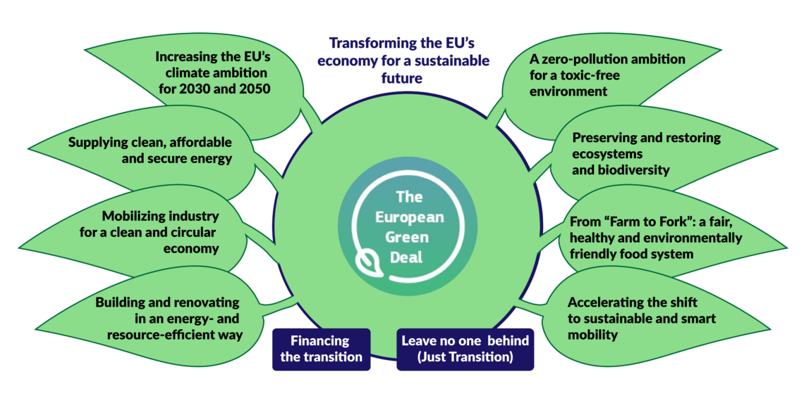

Slide 19
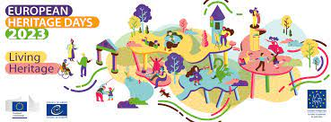
In conclusion, natural and cultural heritage act as a common denominator of integration and sustainability in the EU by promoting cultural exchange, supporting economic development, fostering environmental stewardship, enhancing education and awareness, and providing funding and policy support. By valuing and preserving its diverse heritage, the EU strengthens its unity and sustainability, while promoting a shared sense of identity among its member states.

Slide 20
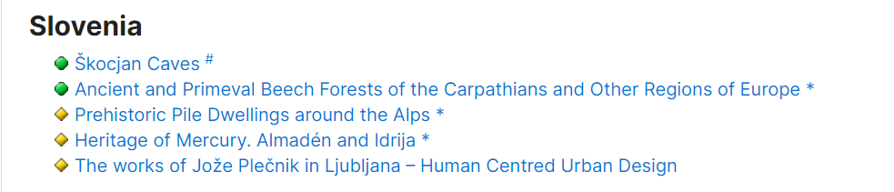

Slide 21
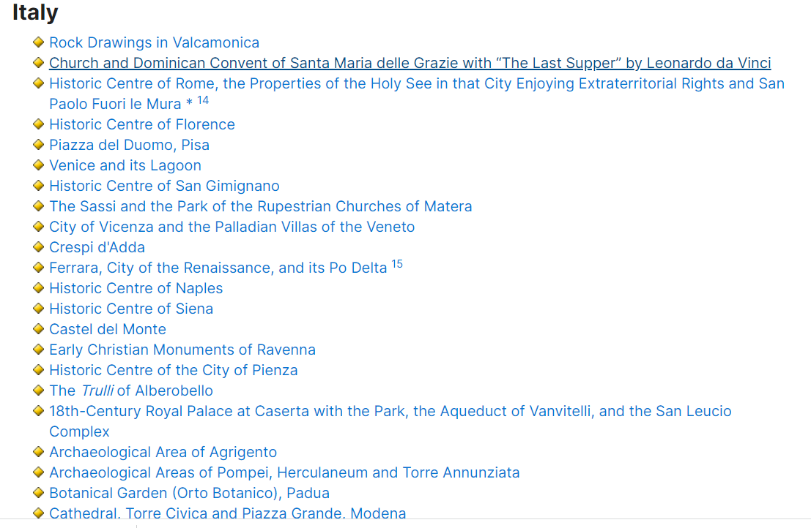

Slide 22
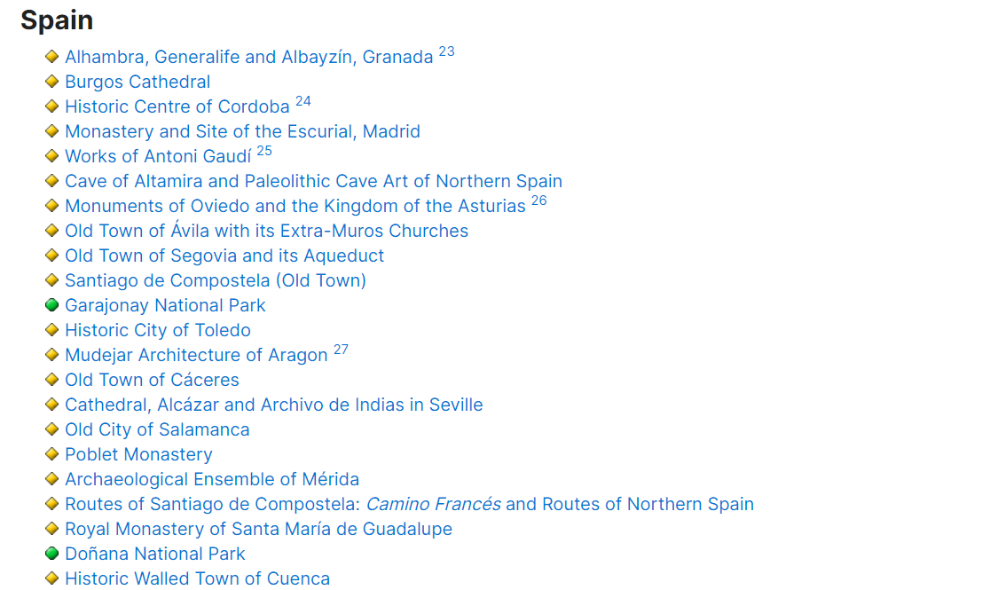

Slide 23
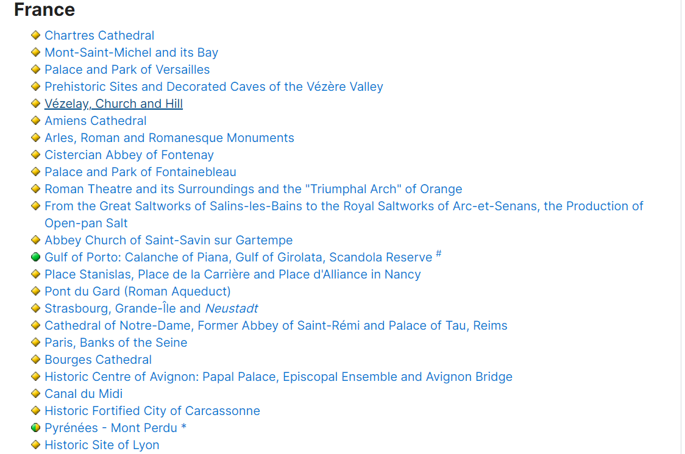

Slide 24
Tangible and intangible Cultural Heritage
Tangible Cultural Heritage’ refers to physical artefacts produced, maintained and transmitted intergenerationally in a society. It includes artistic creations, built heritage such as buildings and monuments, and other physical or tangible products of human creativity that are invested with cultural significance in a society.

Slide 25
‘Intangible Cultural Heritage’ indicates ‘the practices, representations, expressions, knowledge, skills – as well as the instruments, objects, artefacts and cultural spaces associated therewith – that communities, groups and, in some cases, individuals recognize as part of their Cultural Heritage’ (UNESCO, 2003). Examples of intangible heritage are oral traditions, performing arts, local knowledge, and traditional skills.

Slide 26
Tangible and intangible heritage require different approaches for preservation and safeguarding, which has been one of the main motivations driving the conception and ratification of the 2003 UNESCO Convention for the Safeguarding of the Intangible Cultural Heritage. The Convention stipulates the interdependence between intangible Cultural Heritage, and tangible cultural and natural heritage, and acknowledges the role of intangible Cultural Heritage as a source of cultural diversity and a driver of sustainable development.

Slide 27
Recognizing the value of people for the expression and transmission of intangible Cultural Heritage, UNESCO spearheaded the recognition and promotion of living human treasures, ‘persons who possess to a very high degree the knowledge and skills required for performing or recreating specific elements of the intangible Cultural Heritage’.

Slide 28
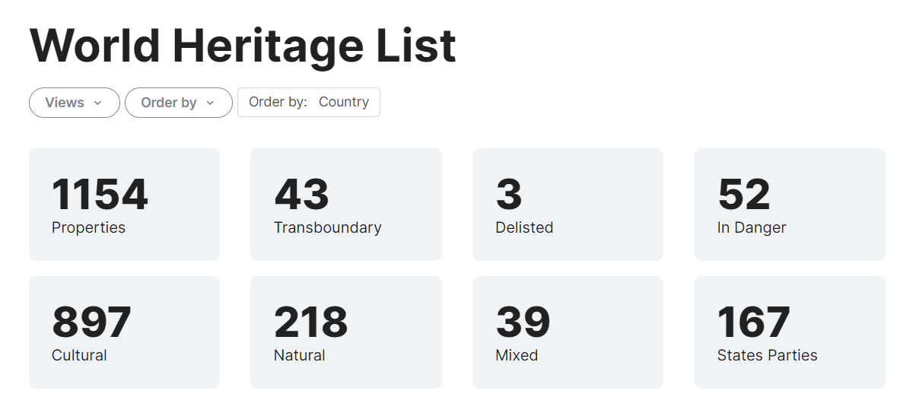

Slide 29
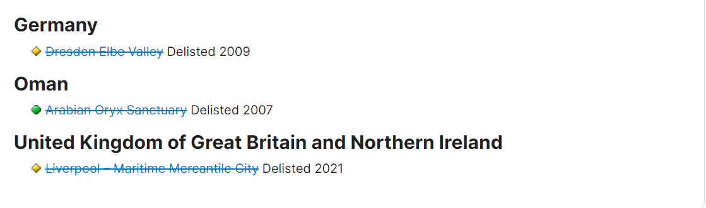

Slide 30
THANK YOU

Slide 31
European Environmental Policy: EU Multiannual Financial Framework 2021-2027 and Green Investment Possibilities
By Dr.
MENSAH C. Marius
Assistant Professor
Faculty of Law- University of Maribor
SZCZECIN, POLAND
March 2022

Slide 32
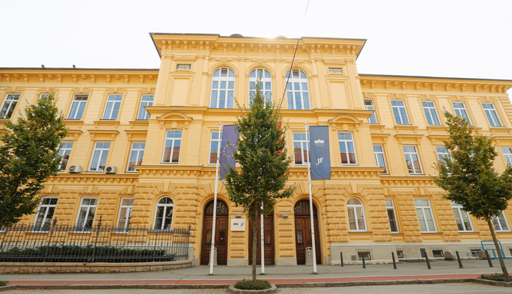

Slide 33
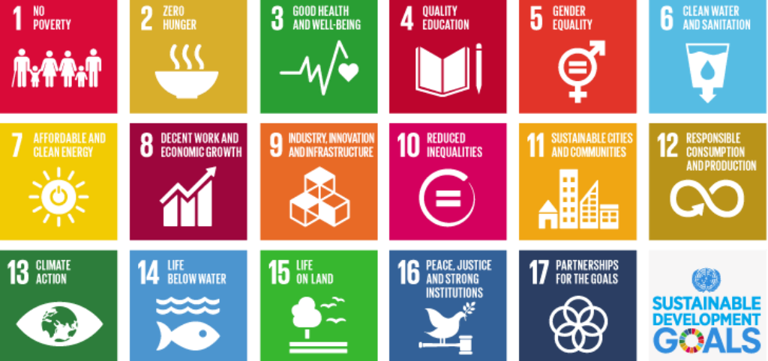
Why sustainable Tourism?

Slide 34
The travel and tourism industry is one of the world’s largest industries with a global economic contribution (direct, indirect and induced) of over 7.6 trillion U.S. dollars in 2016. The direct economic impact of the industry, including accommodation, transportation, entertainment and attractions, was approximately 2.3 trillion U.S. dollars that year.Worldwide, the tourism industry has experienced steady growth almost every year. International tourist arrivals increased from 528 million in 2005 to 1.19 billion in 2015. Figures were forecasted to exceed 1.8 billion by 2030. Each year, Europe receives the most international tourist arrivals. It also produces the most travelers: with approximately 607 million outbound tourists in 2015, the region had more than double that of the second largest tourist origin, the Asia Pacific region.

Slide 35
Slovenian tourism
The Slovenian Tourist Board has defined green (ie sustainable) as the only law for the development opportunity
WHAT DOES IT MEAN?
Integrating sustainability in a holistic way.
Implementation of the Strategy on sustainable growth 2017-2021.
Development and promotion of sustainable products for demanding visitors seeking quality diverse and active experiences.
Continuous efforts to improve economic, environmental, climate and social aspects.
Improvement of hospitality, tourism employee satisfaction (better paid, motivated and educated staff).
Notes:
At its 151st regular session on 5 October 2017, the Government of the Republic of Slovenia adopted the Strategy for the Sustainable Growth of Slovenian Tourism 2017 - 2021.

Slide 36
6 key development policies
New organization: macro destinations and tourism products,
The institutional and legal framework,
Accommodation, tourism infrastructure and investments,
Personnel in tourism,
Space, natural and cultural resources,
Small and medium-sized enterprises (SMEs).

Slide 37
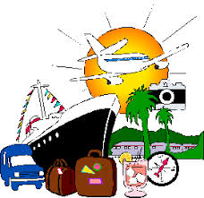
Definition of tourism products
Mountain holidays and outdoor,
Business Meetings & Events
Health & Wellness
Experiences of nature,
Gastronomy,
Culture,
Sun & Sea,
Sport tourism,
Round trips and
Rural tourism.

Slide 38
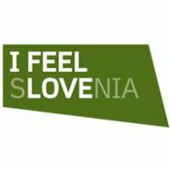
Positive trend of tourism growth this year
(05) Five million tourists (+ 6% more than in the same period last year),
13.2 million overnight stays (+ 2%) and 1.9 billion euros
(+ 3%) in revenue from travel exports.
SLOVENIA has already exceeded the goals in the strategy, namely reaching 5 to 5.5 million tourist visits and 16-18 million overnight stays with last year's very successful year
VISION
Primary goal of reaching € 3.7 - 4 billion in travel inflows. "

Slide 39
The impact of cultural and natural heritage
The impact of cultural and natural heritage on society is very positive. In the pre-pandemic years, natural and cultural heritage was used as an anchor to promote the rich European traditions and stimulate the pride to be part of the EU. Moreover, heritage accounted for the biggest tourist attraction and were the reasons why tourism was able to play a very positive role in the economy of many European countries, making the EU the number 1 visited continent. According to the World Travel and Tourism Council, the economic impact in 2018 of travel and tourism accounted for 10.4% of the global GDP and 9.9% of global employment. In Europe, apart from stimulating intercultural exchanges, natural and cultural heritage empowered the growth of tourism, which accounted for around 782 billion euros in EU GDP in 2018 and created 14.4 million jobs, thanks to direct employment in the sector.

Slide 40
Definitions
EU Environmental Policy refers to EU philosophy, intentions, and objectives regarding the environment.
It is a commitment to the laws, regulations, and other policy mechanisms concerning environmental issues. As we are talking about environment, these policies will concern air and water pollution, waste management, ecosystem management, maintenance of biodiversity, the protection of natural resources, wildlife, endangered species, etc…
Policies concerning energy or regulation of toxic substances including pesticides and many types of industrial waste are part of the topic of environmental policy.

Slide 41
European Union & Environmental law
European Environmental law - or "environmental and natural resources law" is the set of legal norms that regulate environmental relationships in Europe.
Since the 1970s, the European Union (EU) and its member countries have introduced laws to ensure the careful use of natural resources, to minimize adverse environmental impacts of production and consumption, and to protect biodiversity and natural habitats.
The European Union (EU) is considered to have the most extensive environmental laws of any international organization
The Institute for European Environmental Policy estimates the body of EU environmental law amounts to well over 500 Directives, Regulations and other legal documents.

Slide 42
Sustainable development lies on 3 pillars: Environmental policy, economic policy and social policy. Protecting the environment is essential for the quality of life of current and future generations. As environmental problems are global, environmental policies are mainly defined at the international level. EU environmental policy aim is to combat climate change both in Europe and globally through international negotiations, bioenergy, strategies for transport and energy conservation.

Slide 43
Important principles in EUROPE
Precautionary Principle: Pollution is managed and controlled at the source before causing any serious damage.
Prevention: The concept of prevention can perhaps better be considered an overarching aim that gives rise to a multitude of legal mechanisms, including prior assessment of environmental harm, licensing or authorization .
The polluter pays principle: is a well-accepted concept and implemented across the EU. Companies have to pay for damage they cause through negligent management of environmental risks.
Sustainable development: The European Union (EU) established a strategy for sustainable development in May 2001. In endorsing this strategy, the Göteborg European Council recognized that the external dimension needed to be further developed.

Slide 44
Equity: Defined by UNEP to include intergenerational equity - "the right of future generations to enjoy a fair level of the common patrimony“
Transboundary responsibility: Defined in the international law context as an obligation to protect one's own environment, and to prevent damage to neighboring environments, UNEP considers transboundary responsibility at the international level as a potential limitation on the rights of the sovereign state
Public participation and transparency : Identified as essential conditions for "accountable governments . . ., industrial concerns," and organizations generally, public participation and transparency are presented by UNEP as requiring "effective protection of the human right to hold and express opinions and to seek, receive and impart ideas

Slide 45
Environmental Legislation in Europe (Institutions and Bodies)
European Parliament
Committee on environment, public health and food safety
Council of the European Union
European Commission
  Environment
  Climate action
European Economic and Social Committee
  Agriculture, rural development and environment section
Committee of the Regions
  Commission for environment, climate change and energy (ENVE)
European Investment Bank
  European Investment Bank and environment
EU agencies
  European Environment Agency

Slide 46
The EU’s 2021-2027 long-term budget
The EU Multiannual Financial Framework 2021-2027 is also referred to as the EU’s 2021-2027 long-term budget.
From the period of 2021-2027, the EU budget will be €1.074 trillion
The amount is the Union's answer to the ongoing global pandemic and aims to :
Repair the economic and social damage caused by the coronavirus pandemic
To assist companies and individuals to deal with the transition towards a modern and more sustainable Europe.
Develop Earth-friendly technologies,
Infrastructures: Implement the EU Green Deal

Slide 47
The Next Generation EU (NGEU)
Additionally to the EU long term budget, there is The Next Generation EU (NGEU) which is a European Union recovery fund to support Member States mitigate the effects of the COVID-19 pandemic. The European Council agreed on the NGEU on the 21st of July 2020. The fund is worth €750 billion. The NGEU fund will operate from 2021–2023, and will be tied to the regular 2021–2027 budget of the EU's (MFF). The money from NextGenerationEU will be invested across several programmes, and will be distributed to EU countries and beneficiaries through grants (€390 billion) and loans (€360 billion).
The comprehensive NGEU and MFF packages are projected to reach €1824.3 billion= 1 TRILLION 824 BILLION 30 MILLION

Slide 48
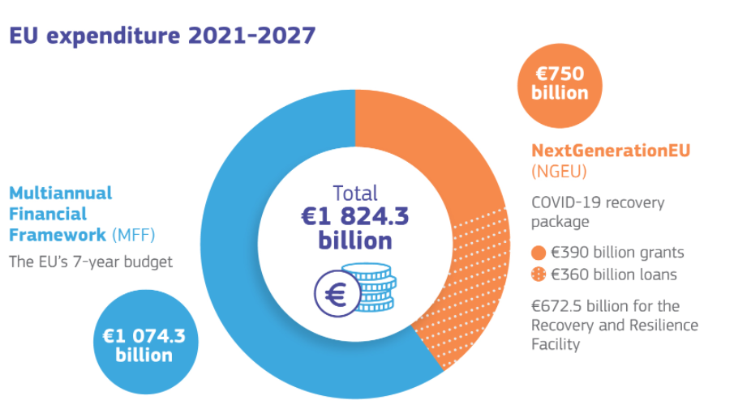
The EU MFF + NGEU

Slide 49
How will the money be spent
More than 50% of the budget will be spent in order to :
Support the modernisation of the European Union through research and innovation; fair climate and digital transitions; preparedness, recovery and resilience
30% of the EU budget will be spent to fight climate change. The package also pays specific attention to biodiversity protection and gender-related issues
20% of NextGenerationEU will be invested in the digital transformation
In 2026 and 2027, 10% of the annual spending under the long-term budget will contribute to halting and reversing the decline of biodiversity

Slide 50
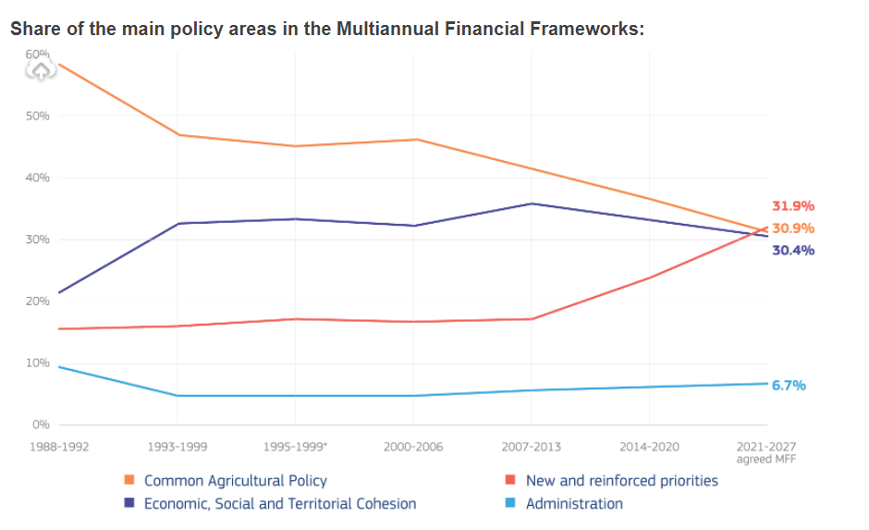

Slide 51
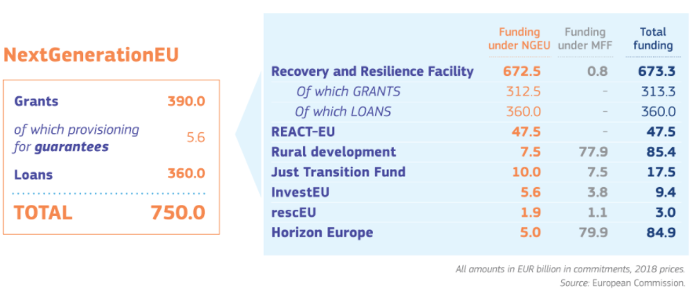
NextGeneration EU: €750 billion for Europe's recovery

Slide 52
Additional Mechanism
To fund NextGenerationEU, the Commission will borrow up to €750 billion. The funds raised will be repaid from future EU budgets or by the Member states concerned, starting after 2027 and by 2058 at the latest.
New sources of revenue to ease the burden on Member States:
The 1st new own resource, already as of 1 January 2021, will be a new contribution based on non-recycled plastic packaging waste. Further new sources of revenue could include a new own resource based on a carbon border adjustment mechanism, a digital levy, and the EU Emission Trading System.
A €5 billion Brexit Adjustment Reserve

Slide 53
The EU Green Deal
The European Green Deal seeks primarily to combat global warming and to offer a decisive response to the many environmental challenges facing all countries.
The Green Deal is the European fulfilment of the COP 21 promise, where all member states of the UN Climate Change Agreement have pledged to reduce their greenhouse gas emissions and keep global warming below 2 ° C by 2100.

Slide 54
This is a step that will encourage investment in infrastructure and green energy. The Green Deal will contribute to the development of a green economy, green technologies, sustainable tourism, sustainable industry and transport in Europe. By 2050, Europe must be climate neutral and its economy and energy must be adapted for sustainable green development. Respiratory diseases caused by pollution treatment costs and impact on the standard of living of the population. The socio-cultural, political and economic consequences of global warming no longer leave doubts about quick action.

Slide 55
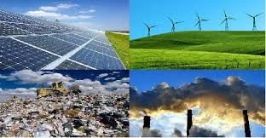
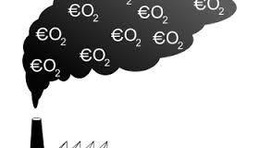

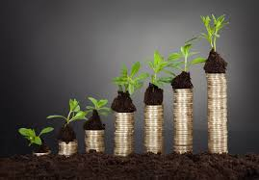

Slide 56
What are we protecting?
Air quality laws :govern the emission of air pollutants into the atmosphere. A specialized subset of air quality laws regulate the quality of air inside buildings.
Water quality laws: govern the release of pollutants into water resources, including surface water, ground water, and storeddrinking water. Some water quality laws, such as drinking water regulations, may be designed solely with reference to human health.
Waste management laws govern the transport, treatment, storage, and disposal of all manner of waste, including municipal solid waste, hazardous waste, and nuclear waste, among many other types.
Chemical safety laws govern the use of chemicals in human activities, particularly man-made chemicals in modern industrial applications.
Road vehicles: Automotive fuel quality
Pollutant emissions from ships: Marine Pollution Convention, MARPOL 73/78
Water resources laws govern the ownership and use of water resources, including surface water and ground water.
Mineral resource laws cover several basic topics, including the ownership of the mineral resource and who can work them.

Slide 57
Pollution and Facts in Europe
A latest research : Europe’s dark cloud Published in June 2016 by WWF European Policy Office and others, reveals that the Total mortality impact of coal power plants in the EU was estimated at 240,000 life years lost, equivalent to about 22,000 premature deaths.
The health and climate impacts of coal power plants are immense, harmful and extremely costly to European countries, with the overall economic costs of health impacts from coal combustion in the EU estimated at up to 62.3 billion Euros. The fact that coal pollution travels means there is no ‘safe spot’ while any coal plant is running.
The report finds that: EU’s currently operational coal-fired power plants were responsible for about 22,900 premature deaths in 2013: this can be compared to 26,000 deaths in road traffic accidents in the EU the same year.
The coal plants were responsible for 11,800 new cases of chronic bronchitis and 21,000 hospital admissions in 2013. The health impacts of EU coal created an overall bill of 32.4 to 62.3 billion Euros
Putting an end to coal-burning power generation across Europe will bring huge benefits for citizens, environment and the economy both at home and abroad. Protecting public health and averting dangerous climate change are two important challenges of our time.

Slide 58
Transboundary pollution
Coal plants in Germany and Poland alone cause over 7,000 premature deaths abroad - 4,700 from Poland and 2,500 from Germany.
Coal plants in the Netherlands cause over 200 premature deaths abroad.
Coal plants in Romania cause 1,600 deaths abroad.
Coal plants in the UK cause 1,300 premature deaths abroad.
The biggest health impacts from coal abroad are seen in France with 1,200 premature deaths caused by coal pollution from Germany, the UK, Poland, Spain and the Czech Republic alone.

Slide 59
Thank you

Slide 60
The Rule of Law and the Sustainable Development Goals
By Dr.
MENSAH C. Marius
Assistant Professor
Faculty of Law- University of Maribor
Cocou.mensah@um.si
2024

Slide 61
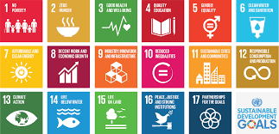
The SDGs
Adopted in January 2016, they represent the new, post-2015 development agenda: a set of 17 goals with 169 targets and further indicators to be pursued by every UN member state until 2030. One of the most significant developments is Goal 16 (peace, justice and strong governance) and nestled under this goal, target 16.3, which emphasises the promotion of the rule of law at national and international levels.

Slide 62
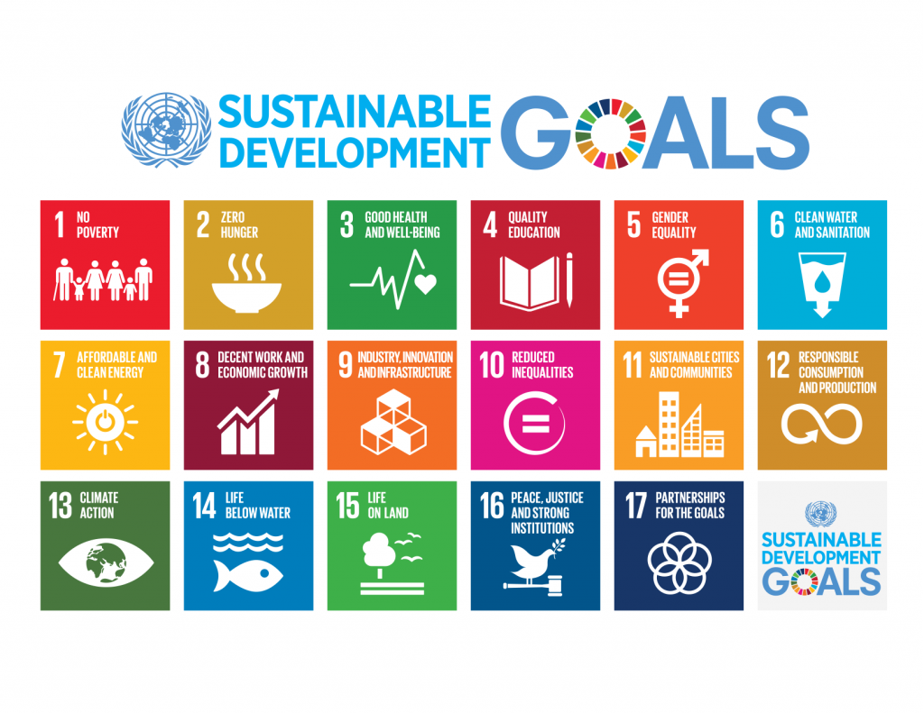

Slide 63

The Right to a Sustainable Planet
Respect for human rights: The law must respect and protect human rights, including the right to a fair trial, freedom of speech and association, and the right to private property.
The rule of law is a fundamental principle of democratic societies, and it is essential for ensuring good governance, protecting human rights, and promoting economic and social development.

Slide 64
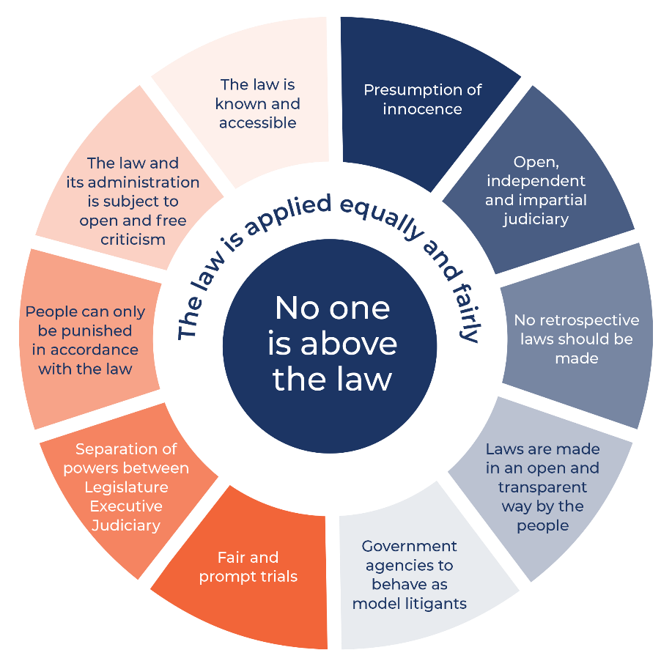
The Rule of Law
The rule of law is a legal concept that refers to the principle that every person, organization, and institution is subject to the law, and that the law must be applied fairly, consistently, and impartially to everyone. The rule of law requires that all individuals and institutions, including government officials and institutions, are bound by and accountable to the law, and that the laws are clear, predictable, and applied without discrimination or arbitrary judgment.

Slide 65
Key legal sources that describe the rule of law
Code of Hammurabi (1754 BC):
The Code of Hammurabi is a set of 282 laws that were inscribed on a black stone pillar in ancient Babylon in 1754 BC. It is one of the oldest surviving legal codes in the world and provides a fascinating glimpse into the legal system of ancient Mesopotamia.
Key principles of the Code of Hammurabi:
Legal equality: The Code of Hammurabi proclaimed that all citizens, regardless of their social status, were subject to the law. This principle was a major step towards establishing a more just and equitable society.
Fairness and impartiality: The Code of Hammurabi required judges to apply the law fairly and impartially, and it prohibited them from taking bribes or showing favoritism.
Retributive justice: The Code of Hammurabi prescribed harsh punishments for certain crimes, such as death or mutilation. However, it also recognized the principle of proportionality, and punishments were generally tailored to the severity of the crime.

Slide 66
Key legal sources that describe the rule of law
Magna Carta (1215): This landmark document is often considered to be a foundational principle of the rule of law. It established the principle that the King was subject to the law and that no person could be arbitrarily imprisoned or deprived of their property without due process. The Magna Carta is a set of 63 clauses agreed to by King John of England and a group of rebel barons in 1215. It is considered to be one of the most important documents in English history and has had a profound impact on the development of the rule of law around the world.

Slide 67
International Covenant on Civil and Political Rights (1966): This international treaty, adopted by the United Nations General Assembly, outlines a number of civil and political rights that are essential for the rule of law. These rights include the right to life, the right to freedom from torture, and the right to a fair trial.
Rome Statute of the International Criminal Court (1998): This international treaty established the International Criminal Court (ICC), which is responsible for investigating and prosecuting individuals accused of the most serious crimes of international concern, including genocide, crimes against humanity, and war crimes. The Rome Statute explicitly recognizes the importance of the rule of law in the context of international criminal justice.

Slide 68
Key legal sources that describe the rule of law
United Nations Charter (1945): The UN Charter, the founding document of the United Nations, explicitly recognises the rule of law as a fundamental principle of international law. Article 2(1) of the Charter states that the UN is based on the principle of the "rule of law.“
UN General Assembly Resolutions:
UN General Assembly Resolution 217 (III) A (1948): This resolution, adopted by the UN General Assembly, affirmed the Universal Declaration of Human Rights, which includes a number of provisions that are essential for the rule of law.
UN Commission on Human Rights Resolution 2000/65 (2000): This resolution called for the strengthening of the rule of law at the national, regional, and international levels.
UN General Assembly Resolution 64/142 (2009): This resolution adopted the Basic Principles on the Rule of Law, which provide a comprehensive framework for understanding and promoting the rule of law.
UN General Assembly Resolution 72/127 (2017): This resolution reaffirmed the importance of the rule of law for achieving sustainable development and peace.

Slide 69
Climate Change
The Intergovernmental Panel on Climate Change (IPCC) has warned that global temperatures could reach or even exceed 1.5 degrees Celsius above pre-industrial levels as early as the next decade unless urgent action is taken to reduce emissions.
To limit global warming to 1.5 degrees Celsius, the world needs to achieve net-zero emissions by around mid-century.
This requires a rapid and deep transformation of the global economy, including phasing out fossil fuels, increasing renewable energy, and implementing energy-efficient technologies. It also requires significant changes in land use, agriculture, and other sectors.
Meeting the 1.5-degree threshold will require unprecedented efforts, but it is crucial to avoid the worst impacts of climate change, such as more frequent and severe heatwaves, droughts, floods, and other extreme weather events, and to protect the planet for future generations.
Governments must adopt policies and regulations that drive the transition to a low-carbon economy and provide financial support for clean energy and climate adaptation. Businesses must reduce their carbon footprint and invest in sustainable technologies and practices. Individuals can reduce their own carbon footprint by making lifestyle changes such as using public transportation, reducing meat consumption, and using energy-efficient appliances.

Slide 71
Countries and islands that are at risk of disappearing due to global warming and climate change
Maldives: The Maldives, an island nation in the Indian Ocean, is one of the most vulnerable countries to sea-level rise. Some projections suggest that the country could be entirely submerged by the end of the century.
1
Marshall Islands: The Marshall Islands, a Pacific island nation, is also highly vulnerable to sea-level rise. The government has already begun planning for the possibility of relocating its entire population to other countries.
2
Tuvalu: Tuvalu, a small island nation in the Pacific, is facing the threat of inundation from rising sea levels. The government has already begun exploring options for relocation.
3
Kiribati: Kiribati, another Pacific island nation, is also highly vulnerable to sea-level rise. The government has purchased land in Fiji as a possible relocation site for its population.
4
Bangladesh: Bangladesh is a low-lying country that is at high risk of flooding and sea-level rise. The country's large population and limited resources make it particularly vulnerable to the impacts of climate change.
5

Slide 72
Pollution facts in the EU
Air pollution: Air pollution is a major problem in the EU, causing an estimated 400,000 premature deaths each year. The main sources of air pollution are transportation, industry, and households. Eastern European countries, such as Poland and Bulgaria, tend to have higher levels of air pollution compared to Western European countries.
Water pollution: Water pollution is also a significant problem in the EU, with agricultural runoff, sewage, and industrial waste being major contributors. This pollution can lead to harmful algal blooms, fish kills, and other ecological impacts.
Waste management: The EU generates around 2.5 billion tons of waste each year, with only about 40% of this waste being recycled or composted. The rest ends up in landfills, where it can contribute to air and water pollution.
Energy consumption: The EU is a major consumer of energy, with the majority of its energy needs being met by fossil fuels. This contributes to greenhouse gas emissions, which contribute to climate change and air pollution.

Slide 73
The Solution
Advocate for stronger laws and policies: Individuals, organizations, and advocacy groups can put pressure on lawmakers to adopt and enforce stronger laws and policies that promote sustainable development. This can be done through lobbying, public campaigns, and other forms of activism.
Use the legal system: Individuals and groups can use the legal system to challenge government decisions that violate environmental laws and regulations. This can include filing lawsuits, engaging in administrative proceedings, and other legal actions.
Increase public awareness: Raising public awareness about sustainable development and the need for stronger laws and regulations can help create a groundswell of support for change. This can be done through education campaigns, social media, and other forms of public engagement.

Slide 74
Promote international cooperation: Sustainable development is a global issue, and international cooperation is essential to address it. Governments, businesses, and civil society organizations can work together to share knowledge, resources, and best practices, and to promote sustainable development goals at the international level.
Promote transparency and accountability: Governments can be held accountable for their actions through transparency and accountability measures such as public reporting, independent monitoring, and citizen participation in decision-making.

Slide 75
THANK YOU

Slide 76
Minorities and Sustainable Development
By Dr.
MENSAH C. Marius
Assistant Professor
Faculty of Law- University of Maribor
Cocou.mensah@um.si

Slide 77
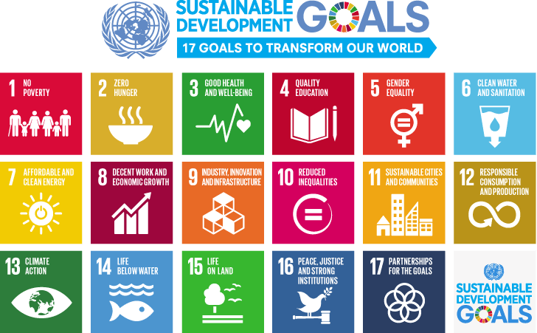

Slide 78
What is an ethnic minority
The term is generally understood to be those groups exhibiting cultural preferences different to those of the majority population, or groups with different cultural and societal origins. However in the empirical field, ‘ethnic minority is likely to refer only to a group of individuals who were born in, or are citizens of, another country. It can also be the case that the term refers only to those individuals with a different racial background. Evidently, this can lead to discrepancies and the omission of data which correctly capture those who can also be regarded as belonging to an ethnic minority: naturalized immigrants; autochthonous minorities who, although present for hundreds of years have not assimilated to natives; and second and third generations of immigrants. Matters are further complicated by countries using different empirical definitions of what it means to be an ethnic minority.

Slide 79
The term can be broad and flexible and encompass all categories of the population of foreign origin (including recent migrants and descendants of previous generations of migrants), ethnic minorities, national minorities, linguistic minorities, religious minorities, and stateless people.

Slide 80
The UN special Rapporteur
The UN has a special Rapporteur on minority issues, Dr. Fernand de Varennes, under Human Rights Council resolution 34/6, and his mandate identified the need for the new global development agenda to include specific goals relating to addressing inequality and promoting social inclusion, which include specific requirements and targets focused on activities to address the situations of disadvantaged minority groups.

Slide 81
The Challenge
Social and economic exclusion remains an everyday challenge to millions of members of ethnic minorities living in Europe today. Underlying differences between ethnic minorities and majority populations, as defined by their cultural and ethnic backgrounds, often correlate with gaps in their labor market outcomes. Being a member of an ethnic minority per se often bears a disadvantage in terms of relative labor market outcomes visà-vis the majority population.

Slide 82
Integration challenges appear in a variety of forms, from unequal access to health care and social services to unemployment, underemployment, and substandard remuneration of individuals belonging to different ethnic minorities. Labor market segmentation is a particularly worrisome issue, since equal labor market opportunities are a cornerstone for achieving not only a high quality of life for minorities themselves but also prosperity and social cohesion for society at large.

Slide 83
Minorities & Environment: THE EU GREEN DEAL
The European Green Deal aims primarily to fight against global warming and to offer a strong response to the multiple environmental challenges facing all countries. The consequences of the above activities will have terrible impacts on the European and world economy, at all levels. Already the respiratory diseases due to pollution, the costs of care, and the impact on the standard of living of the populations is clearly indexed. The socio-cultural, political and economic impacts of global warming no longer leave rapid action in doubt. The role of minorities in implementing the new set of climate action rules is important

Slide 84
THE CHALLENGE
All EU countries* MUST reach the bar zero greenhouse gas emissions by 2050. In the future, all actions, investments, project financing and European policies will consolidate the European climate law, which will systematically reduce public and even private investments in fossil fuels or polluting technology across the EU. , since 2050 is the target year for achieving these goals.
Notes:
* Except Poland.

Slide 85
EFFECTS
·Rationalize the use of available resources
·Promote circular economy focused on recycling and responsible consumption
·Restore ecosystems and biodiversity by fighting against the depletion of species and reducing pollution.
·Support social justice
·Convert or Adapt all sectors of the economy to finance projects that have a positive impact on the environment
·Invest in environmentally friendly technologies
Integration for minorities & complex climate action

Slide 86
Minorities and Heritage
Minorities often serve as custodians of unique intangible heritage—such as languages, rituals, and crafts—ensuring their transmission to future generations while enriching Europe’s cultural diversity. Moreover, Indigenous and minority groups frequently spearhead grassroots efforts to protect endangered heritage sites, combining traditional knowledge with sustainable practices.

Slide 87
Sustainable Tourism Models
Minority-run eco-tourism initiatives—like Basque gastronomic routes or Vlach cultural trails—demonstrate how heritage can drive local economies without compromising ecological or cultural integrity.
Policy Advocacy: Minority representatives push for legal recognition of their heritage within EU and national frameworks (e.g., Catalan linguistic heritage under UNESCO), ensuring protection aligns with sustainability goals.

Slide 88
Minority issues in Asia (as example)
India is a country with diverse ethnic groups. To ensure special rights and benefits for ethnic minority groups aim at the sustainable development of the ethnic groups, the Indian Government has regulations on preferential treatment in terms of policies, capital provision, education and employment opportunities included in its Constitution. In addition to providing legal protection to minorities in the Constitution, the Government also implements national projects to promote socio-economic development in ethnic minority areas, establishing various agencies to manage issues of the groups. Ethnic minorities as key contributors to managing natural resources and addressing climate change. They are the best people to protect the forests. That is why the Government of Viet Nam will strongly prioritise ethnic minorities by providing more resources and opportunities for them to participate in the policy processes.

Slide 89
IN EUROPE
Since 2000 the European Union (EU) has introduced legislation to combat racial and xenophobic discrimination, the problem persists, with the need for new measures recently highlighted by the global Black Lives Matter protests. A number of studies also point to the cost of racial discrimination not only for the individuals concerned but also for society as a whole. For instance, a 2018 EPRS report argued that the loss in earnings caused by racial and ethnic discrimination for both individuals and societies amounts to billions of euros annually. EU citizens also acknowledge this problem: a 2019 survey found that over half of Europeans believe racial or ethnic discrimination to bewidespread in their country.

Slide 90
Solutions
To address racial discrimination and the inequalities it engenders, the European Commission has put forward a number of equality strategies and actions. One such action, the second European summit against racism, was held on 21 March 2022. The European Parliament, meanwhile, has long been demanding an end to racial discrimination. In recent resolutions, the Parliament has called for putting an end to structural racism, discrimination, racial profiling andpolice brutality; for asserting the right to protest peacefully; and for boosting the role of culture, education, media and sport in the fight against racism.

Slide 91
Paul Polman, EX CEO, Unilever
“Business can only flourish in societies in which human rights are respected, upheld and advanced. People are our greatest asset, and empowering them across our supply chain is not only the right thing to do, but also ensures a sustainable future for the business. Our ambition is to embed the promotion of human rights into every function, every role, and every corner of our organization.”

Slide 92
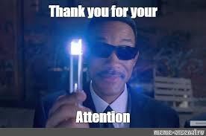

Slide 93
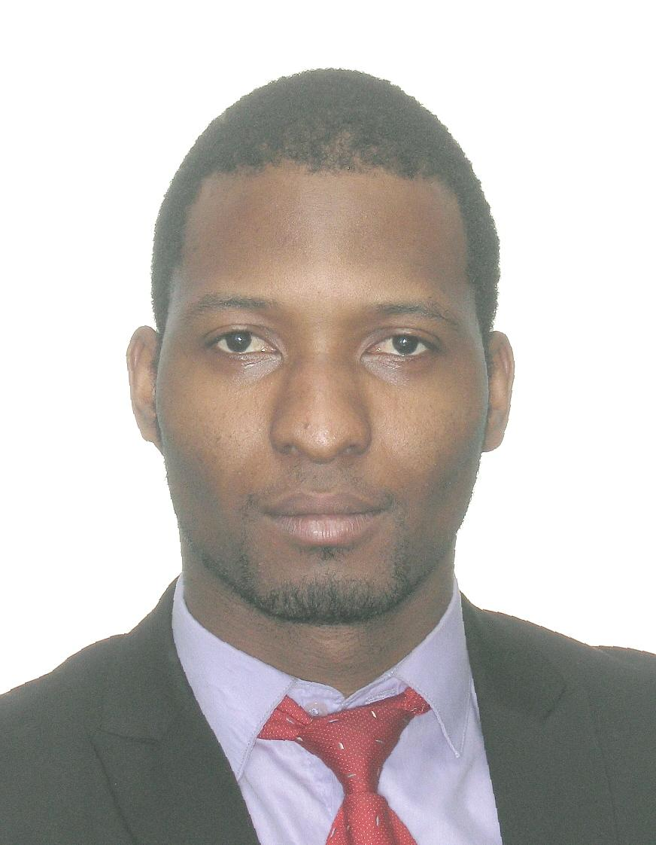

Dr Mensah C. Marius
Assistant Professor,
Faculty of Law, University of Maribor,
Slovenia

Slide 94
SUSTAINABLE DEVELOPMENT IN THE EU AND THE CLIMATE CHALLENGE
By Dr.
MENSAH C. Marius
Assistant Professor
Faculty of Law- University of Maribor
2024

Slide 95
Facts
One million of the eight million species on the planet are endangered:
Our vehicles, industry, consumer habits and human activities are major contributors to deforestation, pollution and deterioration of aquatic life.
Respiratory diseases caused by pollution, treatment costs and impact on the population's standard of living.
The socio-cultural, political and economic consequences of global warming no longer leave any doubts about quick action.

Slide 96
Pollution and Facts in Europe
The last decade: Europe’s dark cloud Published in June 2016 by WWF European Policy Office and others, reveals that the Total mortality impact of coal power plants in the EU was estimated at 240,000 life years lost, equivalent to about 22,000 premature deaths.
The health and climate impacts of coal power plants are immense, harmful and extremely costly to European countries, with the overall economic costs of health impacts from coal combustion in the EU estimated at up to 62.3 billion Euros. The fact that coal pollution travels means there is no ‘safe spot’ while any coal plant is running.
The report finds that: EU’s currently operational coal-fired power plants were responsible for about 22,900 premature deaths in 2013: this can be compared to 26,000 deaths in road traffic accidents in the EU the same year.
The coal plants were responsible for 11,800 new cases of chronic bronchitis and 21,000 hospital admissions in 2013. The health impacts of EU coal created an overall bill of 32.4 to 62.3 billion Euros
Putting an end to coal-burning power generation across Europe will bring huge benefits for citizens, environment and the economy both at home and abroad. Protecting public health and averting dangerous climate change are two important challenges of our time.

Slide 97
The plan
All EU countries MUST achieve zero greenhouse gas emissions by 2050. In the future, all actions, investments, project financing and European policies will be consolidated by European climate legislation, which will systematically reduce public and even private investments in fossil fuels or polluting technologies. throughout the EU. , as the year 2050 is the target year for achieving these goals.

Slide 98
The EU Green Deal
The European Green Deal seeks primarily to combat global warming and to offer a decisive response to the many environmental challenges facing all countries.
The Green Deal is the European fulfilment of the COP 21 promise, where all member states of the UN Climate Change Agreement have pledged to reduce their greenhouse gas emissions and keep global warming below 2 ° C by 2100.

Slide 99
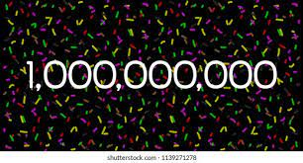
HOW MUCH DOES IT COST?
According to the Commission for the achievement of objectives, mobilized no less than 1 trillion euros in stable investments in the course of the next decade.

Slide 100
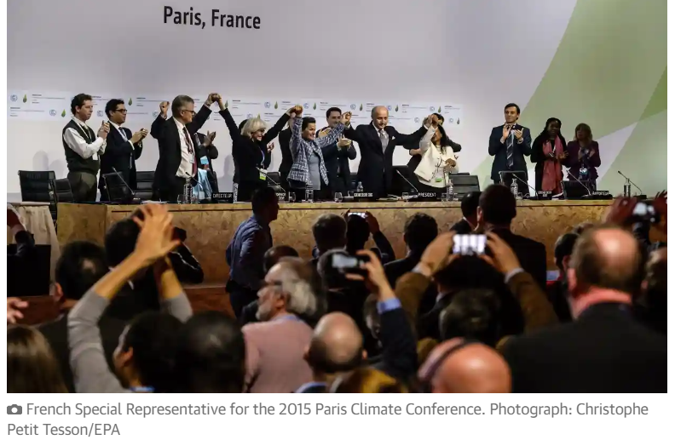

Slide 101
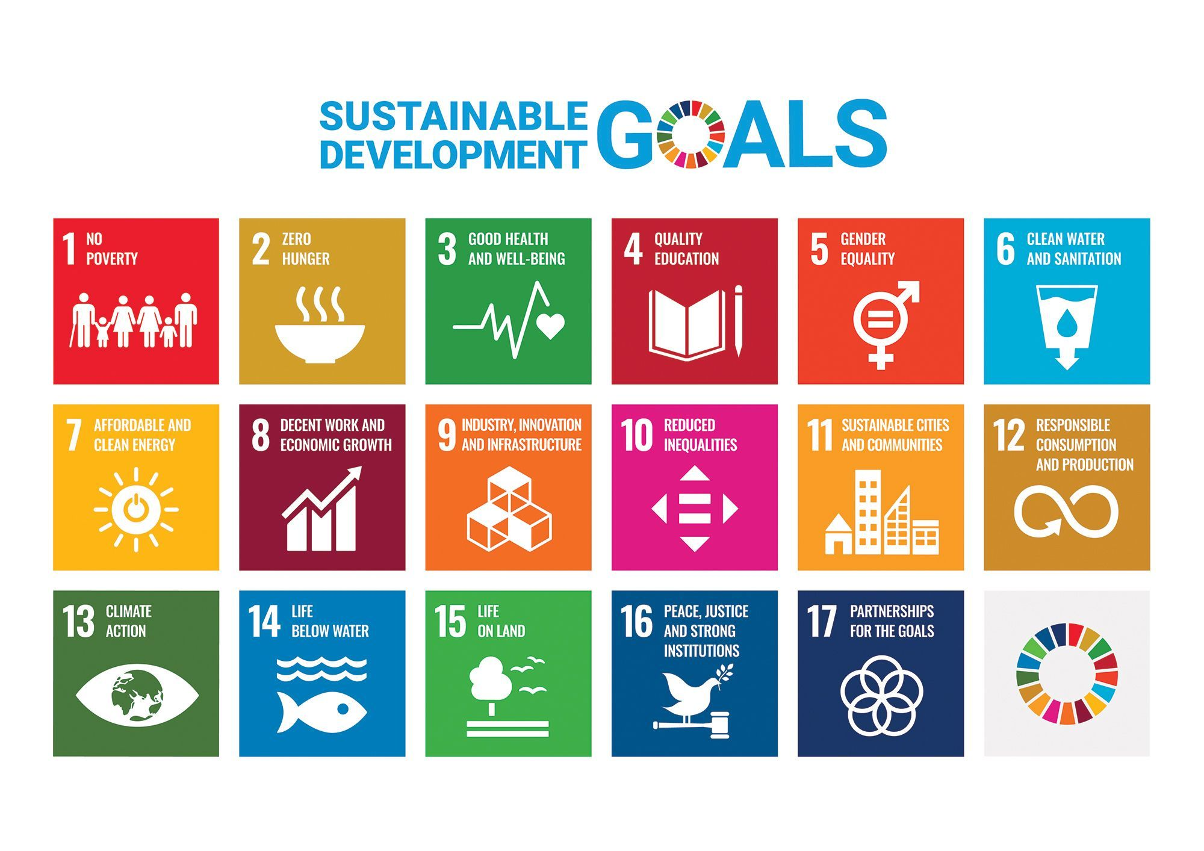

Slide 102
The SDGs were formulated in 2015 by the United Nations General Assembly (UNGA) as part of the Post-2015 Development Agenda, which sought to create a future global development framework to succeed the Millennium Development Goals, which ended that year. They were formally articulated and adopted in a UNGA Resolution called the 2030 Agenda, known colloquially as Agenda 2030. On 6 July 2017, the SDGs were made more "actionable" by a UNGA resolution that identifies specific targets for each goal and provides indicators to measure progress. Most targets are to be achieved by 2030, although some have no end date.

Slide 103
The European Green Deal will transform the EU into a modern, resource-efficient and competitive economy, ensuring:
No net emissions of greenhouse gases by 2050
economic growth decoupled from resource use
No person and no place left behind
The European Green Deal is also our lifeline out of the COVID-19 pandemic. One third of the €1.8 trillion investments from the NextGenerationEU Recovery Plan, and the EU’s seven-year budget will finance the European Green Deal.

Slide 104
The European Commission has adopted a set of proposals to make the EU's climate, energy, transport and taxation policies fit for reducing net greenhouse gas emissions by at least 55% by 2030, compared to 1990 levels. More information on Delivering the European Green Deal.

Slide 105
EU becomes first leading economy to legislate for ‘green tariff’ on imports
Countries that fail to decarbonise industries such as iron and steel face an effective carbon tax
the EU became the first big economy to legislate for a “green tariff” on imports, to be levied on goods that are produced with high carbon dioxide emissions.
The carbon border adjustment mechanism (CBAM) means that countries which fail to green their industries will soon face a new threat: an effective carbon tax that will penalise those hoping to profit from high-carbon activities, and force them to clean up.
The system will be applied at first to iron and steel, cement, fertilisers, aluminium, electricity, hydrogen and some chemicals.

Slide 106
This mechanism promotes the import of goods by non-EU businesses into the EU which fulfil the high climate standards applicable in the 27 EU member states. This will ensure a balanced treatment of such imports and is designed to encourage our partners in the world to join the EU’s climate efforts.”
A sailing boat passing a container ship near Hamburg.
‘It’s a little bit of utopia’: the dream of replacing container ships with sailing boats
Read more
The agreement is still provisional, and details remain to be ironed out by member states and other institutions. But if all goes according to plan, CBAMs (The carbon border adjustment mechanism) will come into force on a trial basis from next October.

Slide 107
Definitions
EU Environmental Policy refers to EU philosophy, intentions, and objectives regarding the environment.
It is a commitment to the laws, regulations, and other policy mechanisms concerning environmental issues. As we are talking about environment, these policies will concern air and water pollution, waste management, ecosystem management, maintenance of biodiversity, the protection of natural resources, wildlife, endangered species, etc…
Policies concerning energy or regulation of toxic substances including pesticides and many types of industrial waste are part of the topic of environmental policy.

Slide 108
The EU’s 2021-2027 long-term budget
The EU Multiannual Financial Framework 2021-2027 is also referred to as the EU’s 2021-2027 long-term budget.
From the period of 2021-2027, the EU budget will be €1.074 trillion
The amount is the Union's answer to the ongoing global pandemic and aims to :
Repair the economic and social damage caused by the coronavirus pandemic
To assist companies and individuals to deal with the transition towards a modern and more sustainable Europe.
Develop Earth-friendly technologies,
Infrastructures: Implement the EU Green Deal

Slide 109
The Next Generation EU (NGEU)
Additionally to the EU long term budget, there is The Next Generation EU (NGEU) which is a European Union recovery fund to support Member States mitigate the effects of the COVID-19 pandemic. The European Council agreed on the NGEU on the 21st of July 2020. The fund is worth €750 billion. The NGEU fund will operate from 2021–2023, and will be tied to the regular 2021–2027 budget of the EU's (MFF). The money from NextGenerationEU will be invested across several programmes, and will be distributed to EU countries and beneficiaries through grants (€390 billion) and loans (€360 billion).
The comprehensive NGEU and MFF packages are projected to reach €1824.3 billion= 1 TRILLION 824 BILLION 30 MILLION

Slide 110
The EU MFF + NGEU

Slide 111
How will the money be spent
More than 50% of the budget will be spent in order to :
Support the modernisation of the European Union through research and innovation; fair climate and digital transitions; preparedness, recovery and resilience
30% of the EU budget will be spent to fight climate change. The package also pays specific attention to biodiversity protection and gender-related issues
20% of NextGenerationEU will be invested in the digital transformation
In 2026 and 2027, 10% of the annual spending under the long-term budget will contribute to halting and reversing the decline of biodiversity

Slide 112
NextGeneration EU: €750 billion for Europe's recovery

Slide 113
Additional Mechanism
To fund NextGenerationEU, the Commission will borrow up to €750 billion. The funds raised will be repaid from future EU budgets or by the Member states concerned, starting after 2027 and by 2058 at the latest.
New sources of revenue to ease the burden on Member States:
The 1st new own resource, already as of 1 January 2021, will be a new contribution based on non-recycled plastic packaging waste. Further new sources of revenue could include a new own resource based on a carbon border adjustment mechanism, a digital levy, and the EU Emission Trading System.
A €5 billion Brexit Adjustment Reserve

Slide 114
Sustainable development lies on 3 pillars: Environmental policy, economic policy and social policy. Protecting the environment is essential for the quality of life of current and future generations. As environmental problems are global, environmental policies are mainly defined at the international level. EU environmental policy aim is to combat climate change both in Europe and globally through international negotiations, bioenergy, strategies for transport and energy conservation.

Slide 115
This is a step that will encourage investment in infrastructure and green energy. The Green Deal will contribute to the development of a green economy, green technologies, sustainable tourism, sustainable industry and transport in Europe. By 2050, Europe must be climate neutral and its economy and energy must be adapted for sustainable green development. Respiratory diseases caused by pollution treatment costs and impact on the standard of living of the population. The socio-cultural, political and economic consequences of global warming no longer leave doubts about quick action.

Slide 116
Transboundary pollution
Coal plants in Germany and Poland alone cause over 7,000 premature deaths abroad - 4,700 from Poland and 2,500 from Germany.
Coal plants in the Netherlands cause over 200 premature deaths abroad.
Coal plants in Romania cause 1,600 deaths abroad.
Coal plants in the UK cause 1,300 premature deaths abroad.
The biggest health impacts from coal abroad are seen in France with 1,200 premature deaths caused by coal pollution from Germany, the UK, Poland, Spain and the Czech Republic alone.

Slide 117
What are we protecting?
Air quality laws :govern the emission of air pollutants into the atmosphere. A specialized subset of air quality laws regulate the quality of air inside buildings.
Water quality laws: govern the release of pollutants into water resources, including surface water, ground water, and storeddrinking water. Some water quality laws, such as drinking water regulations, may be designed solely with reference to human health.
Waste management laws govern the transport, treatment, storage, and disposal of all manner of waste, including municipal solid waste, hazardous waste, and nuclear waste, among many other types.
Chemical safety laws govern the use of chemicals in human activities, particularly man-made chemicals in modern industrial applications.
Road vehicles: Automotive fuel quality
Pollutant emissions from ships: Marine Pollution Convention, MARPOL 73/78
Water resources laws govern the ownership and use of water resources, including surface water and ground water.
Mineral resource laws cover several basic topics, including the ownership of the mineral resource and who can work them.

Slide 118
European Union & Environmental law
European Environmental law - or "environmental and natural resources law" is the set of legal norms that regulate environmental relationships in Europe.
Since the 1970s, the European Union (EU) and its member countries have introduced laws to ensure the careful use of natural resources, to minimize adverse environmental impacts of production and consumption, and to protect biodiversity and natural habitats.
The European Union (EU) is considered to have the most extensive environmental laws of any international organization
The Institute for European Environmental Policy estimates the body of EU environmental law amounts to well over 500 Directives, Regulations and other legal documents.

Slide 119
Important principles in EUROPE
Precautionary Principle: Pollution is managed and controlled at the source before causing any serious damage.
Prevention: The concept of prevention can perhaps better be considered an overarching aim that gives rise to a multitude of legal mechanisms, including prior assessment of environmental harm, licensing or authorization .
The polluter pays principle: is a well-accepted concept and implemented across the EU. Companies have to pay for damage they cause through negligent management of environmental risks.
Sustainable development: The European Union (EU) established a strategy for sustainable development in May 2001. In endorsing this strategy, the Göteborg European Council recognized that the external dimension needed to be further developed.

Slide 120
Equity: Defined by UNEP to include intergenerational equity - "the right of future generations to enjoy a fair level of the common patrimony“
Transboundary responsibility: Defined in the international law context as an obligation to protect one's own environment, and to prevent damage to neighboring environments, UNEP considers transboundary responsibility at the international level as a potential limitation on the rights of the sovereign state
Public participation and transparency : Identified as essential conditions for "accountable governments . . ., industrial concerns," and organizations generally, public participation and transparency are presented by UNEP as requiring "effective protection of the human right to hold and express opinions and to seek, receive and impart ideas

Slide 121
Environmental Legislation in Europe (Institutions and Bodies)
European Parliament
Committee on environment, public health and food safety
Council of the European Union
European Commission
  Environment
  Climate action
European Economic and Social Committee
  Agriculture, rural development and environment section
Committee of the Regions
  Commission for environment, climate change and energy (ENVE)
European Investment Bank
  European Investment Bank and environment
EU agencies
  European Environment Agency

Slide 124
Thank you

Slide 126

GREEN TOURISM LAW - MANAGEMENT OF THE NATURAL AND CULTURAL VALUES, SUSTAINABLE TOURISM
Mensah cocou marius
SENIOR RESEARCH ASSOCIATE
Law faculty
University of maribor

Slide 127
The travel and tourism industry is one of the world’s largest industries with a global economic contribution (direct, indirect and induced) of over 7.6 trillion U.S. dollars in 2016. The direct economic impact of the industry, including accommodation, transportation, entertainment and attractions, was approximately 2.3 trillion U.S. dollars that year.Worldwide, the tourism industry has experienced steady growth almost every year. International tourist arrivals increased from 528 million in 2005 to 1.19 billion in 2015. Figures were forecasted to exceed 1.8 billion by 2030. Each year, Europe receives the most international tourist arrivals. It also produces the most travelers: with approximately 607 million outbound tourists in 2015, the region had more than double that of the second largest tourist origin, the Asia Pacific region.

Slide 128
Why sustainable Tourism?

Slide 129
Slovenian tourism
The Slovenian Tourist Board has defined green (ie sustainable) as the only law for the development opportunity
WHAT DOES IT MEAN?
Integrating sustainability in a holistic way.
Implementation of the Strategy on sustainable growth 2017-2021.
Development and promotion of sustainable products for demanding visitors seeking quality diverse and active experiences.
Continuous efforts to improve economic, environmental, climate and social aspects.
Improvement of hospitality, tourism employee satisfaction (better paid, motivated and educated staff).
Notes:
At its 151st regular session on 5 October 2017, the Government of the Republic of Slovenia adopted the Strategy for the Sustainable Growth of Slovenian Tourism 2017 - 2021.

Slide 130
6 key development policies
New organization: macro destinations and tourism products,
The institutional and legal framework,
Accommodation, tourism infrastructure and investments,
Personnel in tourism,
Space, natural and cultural resources,
Small and medium-sized enterprises (SMEs).

Slide 131
Definition of tourism products
Mountain holidays and outdoor,
Business Meetings & Events
Health & Wellness
Experiences of nature,
Gastronomy,
Culture,
Sun & Sea,
Sport tourism,
Round trips and
Rural tourism.

Slide 132
CHARACTER OF MEDITERRANEAN SLOVENIA:
Mediterranean diversity, karst natural wonders.
Portorož/Piran
Izola
Koper
Ankaran
Postojnska jama/Postojna (Kras)
Lipica in Škocjanske jame (Kras)
Nova Gorica in Vipavska dolina
Brda

Slide 133
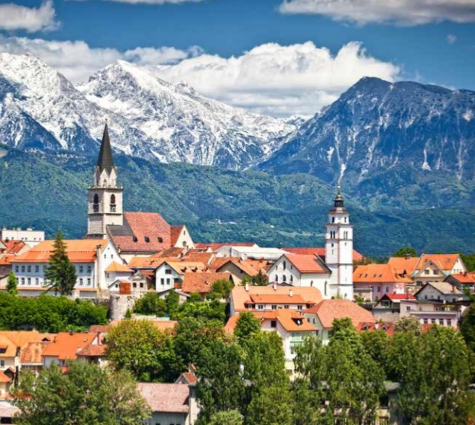
Picturesque and year-round active Alpine beats.
* Bled
Kranjska Gora
Dolina Soče (Bovec, Kobarid, Tolmin)
Bohinj
Radovljica
Kranj
Maribor (Maribor - Pohorje)
Zreče (Rogla - Pohorje)
Zgornja Savinjska dolina
Koroška

Slide 134
Positive trend of tourism growth this year
(05) Five million tourists (+ 6% more than in the same period last year),
13.2 million overnight stays (+ 2%) and 1.9 billion euros
(+ 3%) in revenue from travel exports.
SLOVENIA has already exceeded the goals in the strategy, namely reaching 5 to 5.5 million tourist visits and 16-18 million overnight stays with last year's very successful year
VISION
Primary goal of reaching € 3.7 - 4 billion in travel inflows. "

Slide 135
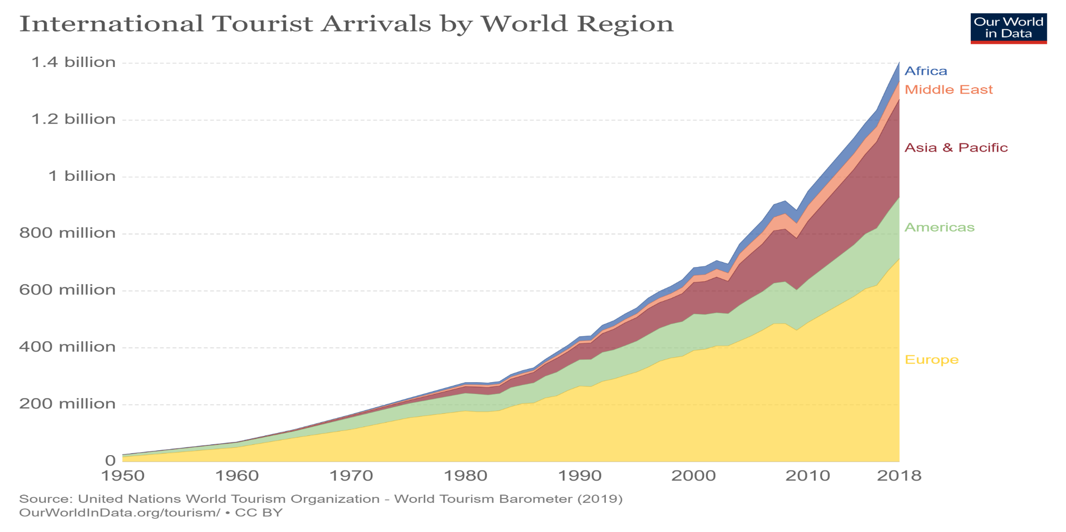

Slide 137
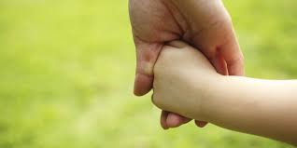
Thank you for your attention

Slide 138


Slide 139
GREEN TOURISM LAW - MANAGEMENT OF THE NATURAL AND CULTURAL VALUES, SUSTAINABLE TOURISM
Mensah cocou marius
SENIOR RESEARCH ASSOCIATE
Law faculty
University of maribor

Slide 140
The travel and tourism industry is one of the world’s largest industries with a global economic contribution (direct, indirect and induced) of over 7.6 trillion U.S. dollars in 2016. The direct economic impact of the industry, including accommodation, transportation, entertainment and attractions, was approximately 2.3 trillion U.S. dollars that year.Worldwide, the tourism industry has experienced steady growth almost every year. International tourist arrivals increased from 528 million in 2005 to 1.19 billion in 2015. Figures were forecasted to exceed 1.8 billion by 2030. Each year, Europe receives the most international tourist arrivals. It also produces the most travelers: with approximately 607 million outbound tourists in 2015, the region had more than double that of the second largest tourist origin, the Asia Pacific region.

Slide 141
Why sustainable Tourism?

Slide 142
Slovenian tourism
The Slovenian Tourist Board has defined green (ie sustainable) as the only law for the development opportunity
WHAT DOES IT MEAN?
Integrating sustainability in a holistic way.
Implementation of the Strategy on sustainable growth 2017-2021.
Development and promotion of sustainable products for demanding visitors seeking quality diverse and active experiences.
Continuous efforts to improve economic, environmental, climate and social aspects.
Improvement of hospitality, tourism employee satisfaction (better paid, motivated and educated staff).
Notes:
At its 151st regular session on 5 October 2017, the Government of the Republic of Slovenia adopted the Strategy for the Sustainable Growth of Slovenian Tourism 2017 - 2021.

Slide 143
6 key development policies
New organization: macro destinations and tourism products,
The institutional and legal framework,
Accommodation, tourism infrastructure and investments,
Personnel in tourism,
Space, natural and cultural resources,
Small and medium-sized enterprises (SMEs).

Slide 144
Definition of tourism products
Mountain holidays and outdoor,
Business Meetings & Events
Health & Wellness
Experiences of nature,
Gastronomy,
Culture,
Sun & Sea,
Sport tourism,
Round trips and
Rural tourism.

Slide 145
CHARACTER OF MEDITERRANEAN SLOVENIA:
Mediterranean diversity, karst natural wonders.
Portorož/Piran
Izola
Koper
Ankaran
Postojnska jama/Postojna (Kras)
Lipica in Škocjanske jame (Kras)
Nova Gorica in Vipavska dolina
Brda

Slide 146
Picturesque and year-round active Alpine beats.
* Bled
Kranjska Gora
Dolina Soče (Bovec, Kobarid, Tolmin)
Bohinj
Radovljica
Kranj
Maribor (Maribor - Pohorje)
Zreče (Rogla - Pohorje)
Zgornja Savinjska dolina
Koroška

Slide 147
Positive trend of tourism growth this year
(05) Five million tourists (+ 6% more than in the same period last year),
13.2 million overnight stays (+ 2%) and 1.9 billion euros
(+ 3%) in revenue from travel exports.
SLOVENIA has already exceeded the goals in the strategy, namely reaching 5 to 5.5 million tourist visits and 16-18 million overnight stays with last year's very successful year
VISION
Primary goal of reaching € 3.7 - 4 billion in travel inflows. "

Slide 150
Thank you for your attention

Slide 152
HUMAN RIGHTS 2.0 & THE EUROPEAN GREEN DEAL
Dr. Mensah cocou marius
SENIOR RESEARCH ASSOCIATE
Faculty OF Law
University of maribor

Slide 153
A Universal Declaration
The 1948 Universal Declaration of Human Rights was drawn up by representatives of many nations to prevent a recurrence of the atrocities of the Second World War and is the cornerstone of modern human rights law.

Slide 154
INTERNATIONAL CODIFICATION
The Universal Declaration is codified in international law through the International Covenant on Civil and Political Rights (ICCPR) and the International Covenant on Economic, Social and Cultural Rights (ICESCR), each of which has been ratified by over 160 States (over three-quarters of all nations). It is recognised that both sets of rights are indivisible and interdependent, and equally important.

Slide 155
BUSINESS & HUMAN RIGHTS
A 2015 survey of The Economist Intelligence Unit found that a majority of business executives now recognise that business is an important player in respecting human rights, and that what their companies do – or fail to do – affects those rights. Business is increasingly recognising the importance of human rights.

Slide 156
Guiding Principles on Business and Human Rights
In 2011 the UN unanimously endorsed the Guiding Principles on Business and Human Rights (the UN Guiding Principles) which sets out the responsibilities business have with regard to human rights. The UN Guiding Principles clarify that the scope of business’ responsibility to respect human rights extends, at a minimum, to those rights expressed in the International Bill of Human Rights and the principles concerning fundamental rights set out in the International Labour Organization’s Declaration on Fundamental Principles and Rights at Work.

Slide 157
WHERE ARE WE GOING?

Slide 158
THE EU GREEN DEAL
The European Green Deal aims primarily to fight against global warming and to offer a strong response to the multiple environmental challenges facing all countries. The consequences of the above activities will have terrible impacts on the European and world economy, at all levels. Already the respiratory diseases due to pollution, the costs of care, and the impact on the standard of living of the populations is clearly indexed. The socio-cultural, political and economic impacts of global warming no longer leave rapid action in doubt.

Slide 159
A STEP FORWARD
It is a step that will promote investments in infrastructure and green energy. The Green Deal will foster in Europe green economy, green technology, sustainable tourism, sustainable industry and transport. By 2050, Europe should be climate neutral and its economy and energy adapted to sustain green development.
The EU green agreement will be binding because it will be incorporated into the first European climate law.

Slide 160
THE CHALLENGE
All EU countries* MUST reach the bar zero greenhouse gas emissions by 2050. In the future, all actions, investments, project financing and European policies will consolidate the European climate law, which will systematically reduce public and even private investments in fossil fuels or polluting technology across the EU. , since 2050 is the target year for achieving these goals.
Notes:
* Except Poland.

Slide 161
EFFECTS
· Rationalize the use of available resources
· Promote circular economy focused on recycling and responsible consumption
· Restore ecosystems and biodiversity by fighting against the depletion of species and reducing pollution.
· Support social justice
· Convert or Adapt all sectors of the economy to finance projects that have a positive impact on the environment
· Invest in environmentally friendly technologies

Slide 162
Support green innovation
· Encourage clean and accessible transportation for all
· Encourage nature-friendly agriculture.
· Assist polluting industries to transfer to more civic and environment-friendly activities- guarantying thus justice and social security.
· Implement the United Nation’s 2030 Agenda and the sustainable development goals

Slide 163
Paul Polman, EX CEO, Unilever
“Business can only flourish in societies in which human rights are respected, upheld and advanced. People are our greatest asset, and empowering them across our supply chain is not only the right thing to do, but also ensures a sustainable future for the business. Our ambition is to embed the promotion of human rights into every function, every role, and every corner of our organization.”

Slide 165
Thank you for your attention

Slide 167
Trajnostni razvoj in varstvo dediščine v EU
Docent
MENSAH C. Marius
Pravna fakulteta Univerze v Mariboru
Cocou.mensah@um.si

Slide 168
Trajnostni razvoj
Trajnostni razvoj pomeni izkoreninjenje revščine, zmanjšanje neenakosti in spodbujanje trajnostnega upravljanja naravnih virov in ekosistemov ter trajnostne, vključujoče in pravične gospodarske rasti. Torej, gre za razvoj, ki zadovoljuje potrebe sedanje generacije, ne da bi pri tem ogrozil zmožnost prihodnjih generacij, da zadovoljijo svoje potrebe.

Slide 169
Za doseganje trajnostnega razvoja je ključno uskladiti tri ključne elemente: gospodarsko rast, socialno vključenost in varstvo okolja. Ti elementi so med seboj povezani in vsi so bistveni za blaginjo posameznikov in družb.
Svetovni voditelji so se na to pot zavezali s sprejetjem ciljev trajnostnega razvoja na zgodovinskem vrhu Združenih narodov (ZN) leta 2015.

Slide 170
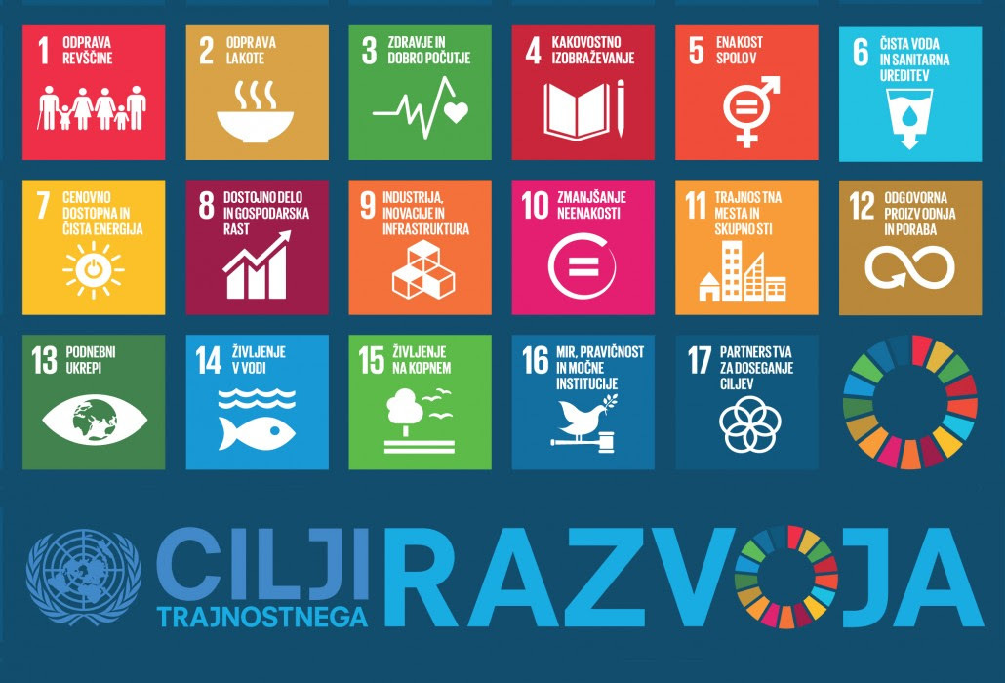

Slide 171
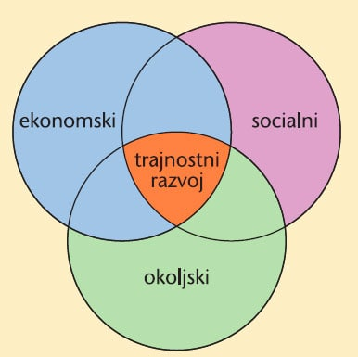

Slide 172
DEDIŠČINA
Dediščina je naš zaklad iz preteklosti, to, s čimer živimo danes, in kar prenašamo na prihodnje rodove. Naša kulturna in naravna dediščina sta nenadomestljiva vira življenja in navdiha. Organizacija Združenih narodov za izobraževanje, znanost in kulturo (UNESCO) si prizadeva spodbujati identifikacijo, zaščito in ohranjanje kulturne in naravne dediščine po vsem svetu, ki velja za izjemno vrednost za človeštvo.

Slide 173
To je utelešeno v mednarodni pogodbi, imenovani Konvencija o varstvu svetovne kulturne in naravne dediščine, ki jo je Unesco sprejel leta 1972.
Koncept svetovne dediščine je izjemen zaradi njegove univerzalne uporabe. Mesta svetovne dediščine pripadajo vsem narodom sveta, ne glede na ozemlje, na katerem se nahajajo.

Slide 174
Ohranjanje kulturne dediščine
Dogodek, ki je vzbudil posebno mednarodno zaskrbljenost, je bila odločitev za izgradnjo Asuanskega visokega jezu v Egiptu, ki bi poplavil dolino, v kateri so templji Abu Simbel, zaklad starodavne egipčanske civilizacije. Leta 1959 je UNESCO po pozivu vlad Egipta in Sudana začel mednarodno zaščitno kampanjo. Pospešene so bile arheološke raziskave na poplavljenih območjih. Predvsem pa sta bila templja Abu Simbel in Philae razstavljena, prestavljena na suha tla in ponovno sestavljena.

Slide 175
Kampanja je stala približno 80 milijonov ameriških dolarjev, od tega je polovico prispevalo okoli 50 držav, kar kaže na pomen solidarnosti in skupne odgovornosti narodov pri ohranjanju izjemnih kulturnih znamenitosti. Njegov uspeh je privedel do drugih zaščitnih akcij, kot so reševanje Benetk in njihove lagune (Italija) in arheoloških ruševin v Moenjodaru (Pakistan) ter obnova tempeljskih kompleksov Borobodurja (Indonezija).Posledično je UNESCO s pomočjo Mednarodnega sveta za spomenike in znamenitosti (ICOMOS) začel pripravo osnutka konvencije o varstvu kulturne dediščine.

Slide 176
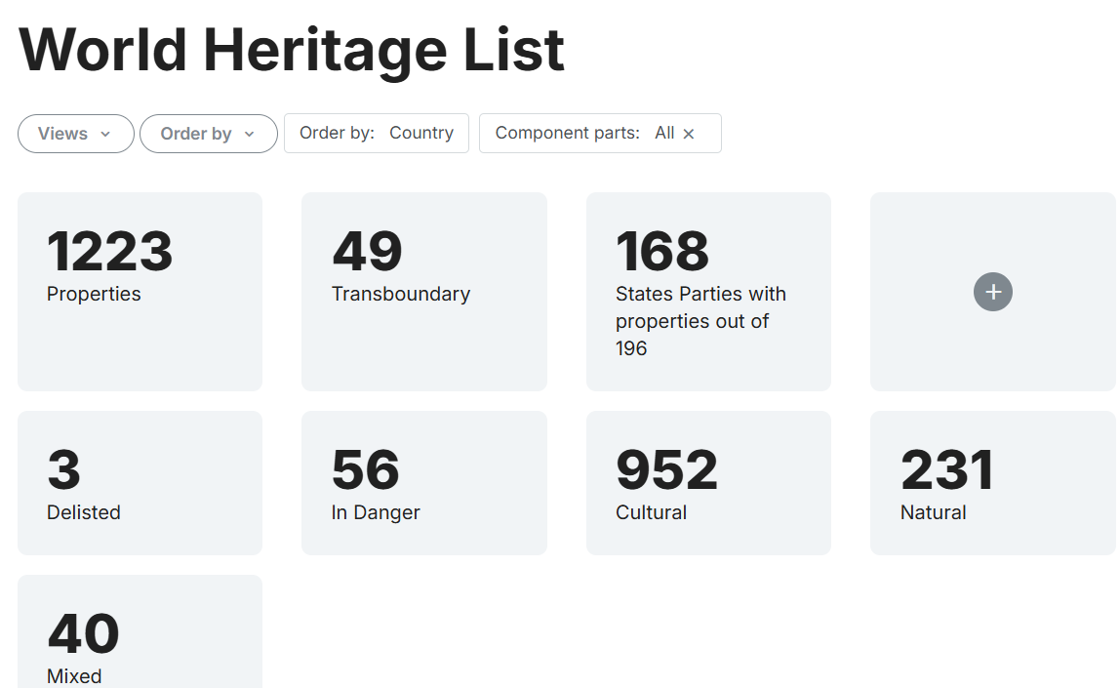
Seznam svetovne dediščine - https://whc.unesco.org/en/list/

Slide 177
" Izbrisana svetovna dediščina"

Slide 178
Unescovi zakladi v Sloveniji
Slovenija je bogata z biseri naravne in kulturne dediščine. Nekateri izmed njih predstavljajo pomemben kamenček v mozaiku svetovne dediščine človeštva in sodijo pod okrilje UNESCO. Na seznamu svetovne naravne in kulturne dediščine so se tako znašle dve naravni in tri kulturne znamenitosti. Na reprezentativni seznam svetovne nesnovne kulturne dediščine človeštva je uvrščenih sedem posebnosti Slovenije svetovne dediščine. Poleg tega se Slovenija pojavlja tudi v drugih programih UNESCO, denimo v svetovni mreži biosfernih območij, svetovni mreži geoparkov in na UNESCO seznamu pisne kulturne dediščine Spomin sveta.

Slide 179
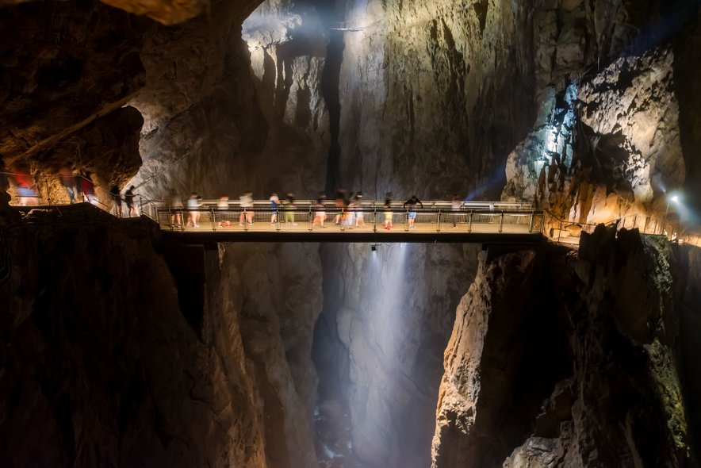
Škocjanske jame

Slide 180
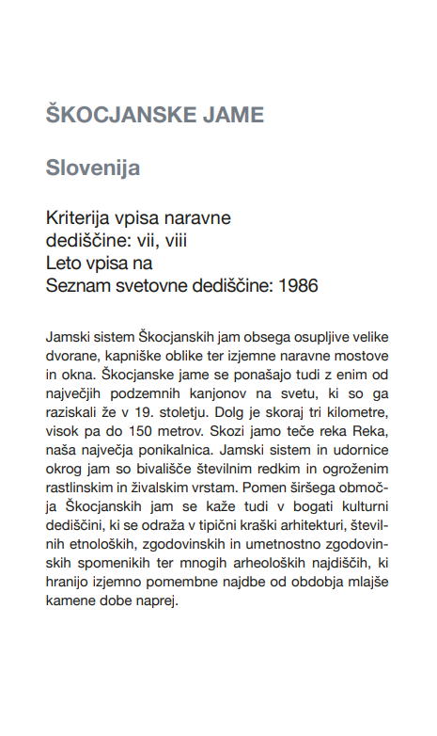

Slide 181
Prvinski bukovi gozdovi v Sloveniji
Območja prvinskih bukovih gozdov Karpatov in drugih evropskih regij predstavljajo najbolje ohranjene dele bukovih gozdov, ki so od zadnje ledene dobe pred 12.000 leti odigrali pomembno vlogo pri razvoju in vplivu bukovih ekosistemov v Evropi. Med temi območji sta tudi gozdna rezervata Pragozd Krokar in Snežnik-Ždrocle. Pragozd Krokar je čudovit košček neokrnjene narave, ki leži v osrčju Kočevskih gozdov. V ta pragozd človeška roka še ni posegla, je pa dom avtohtonim vrstam zveri, v prvi vrsti rjavega medveda, in pticam. Starodavni bukovi gozdovi šumijo tudi v rezervatu Snežnik Ždrocle. Oba rezervata sta del zaščitenega omrežja Natura 2000.

Slide 182
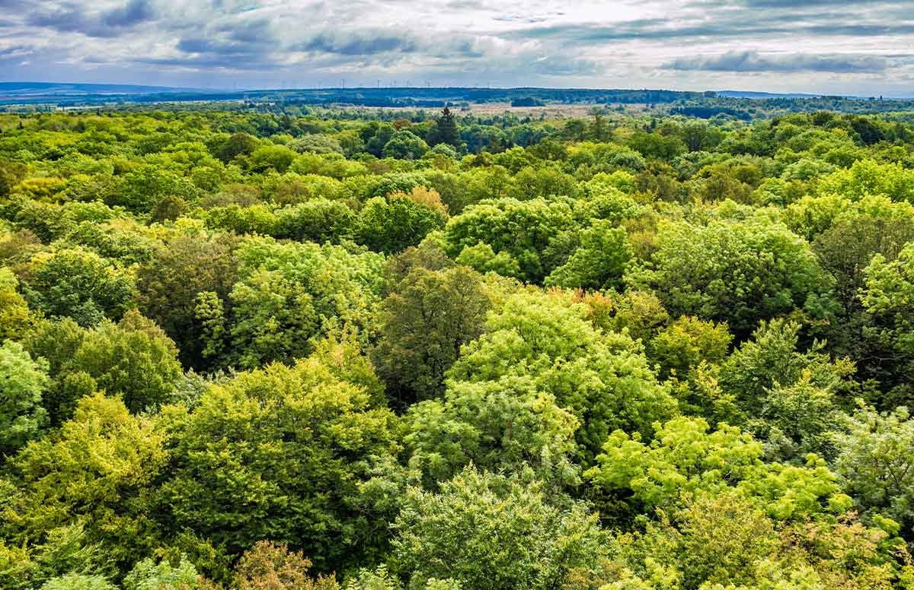

Slide 183
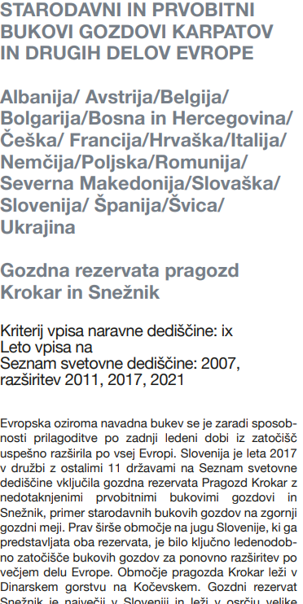

Slide 184
Kulturna dediščina
V kategoriji kulturne dediščine so na Unescov seznam svetovne dediščine vpisana tri spomeniška območja v Sloveniji:
Prazgodovinska kolišča na Igu na Ljubljanskem barju v okviru transnacionalnega serijskega območja prazgodovinskih kolišč okoli Alp (vpis leta 2011, šest držav);
Dediščina živega srebra Idrija-Almaden (vpis l. 2012);
Dela Jožeta Plečnika v Ljubljani - urbano oblikovanje po meri človeka (vpis l. 2021).

Slide 185
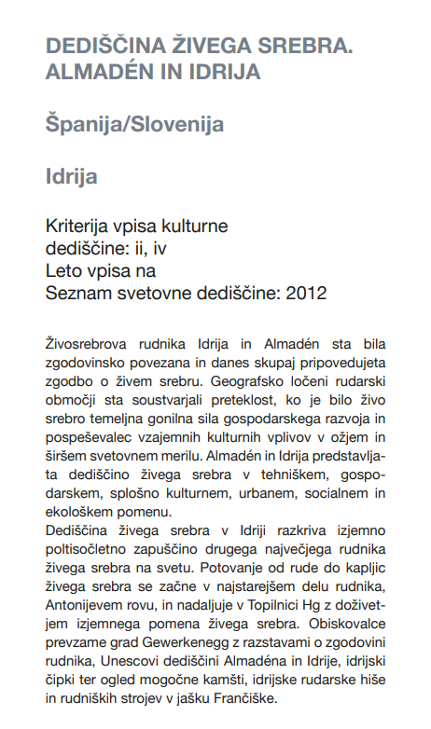
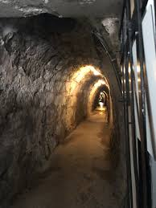

Slide 186
Idrija je skupaj s španskim Almadenom varuh svetovno pomembne dediščine rudarjenja živega srebra. Idrijski Antonijev rov je iz leta 1500 in slovi kot eden najstarejših vhodov v rudnike v vsej Evropi. Z dediščino rudarjenja in življenjem nekdanjih rudarskih družin so povezane številne znamenitosti Idrije: od presenetljive tehniške dediščine, ki jo hrani muzej na gradu Gewerkenegg, do tradicije izvirnega čipkarstva.

Slide 187
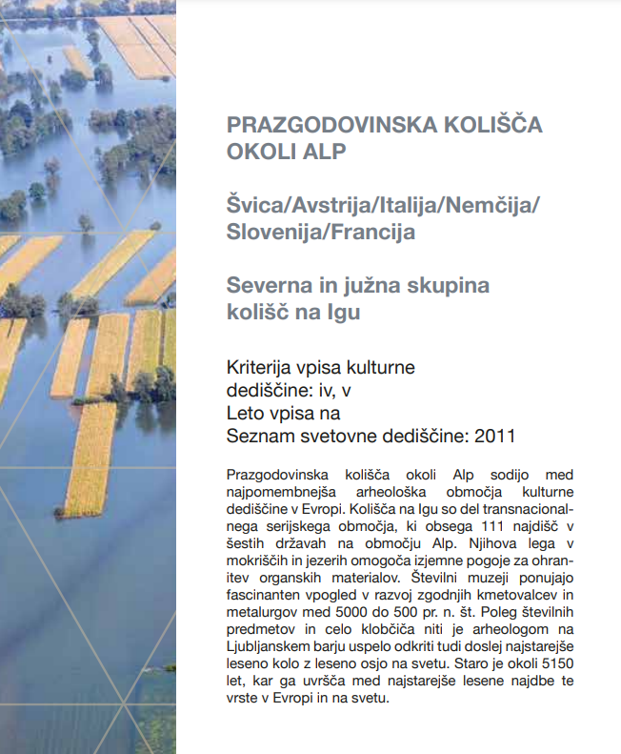

Slide 188
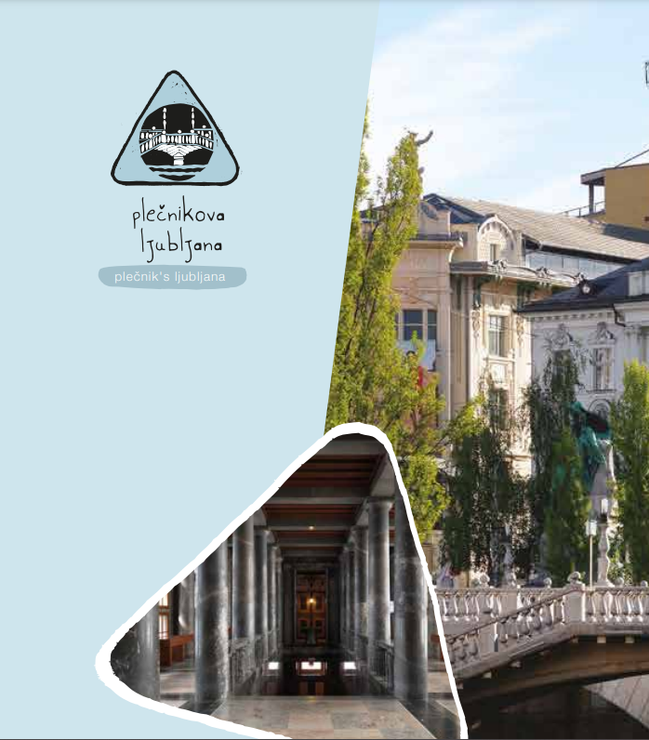

Slide 189
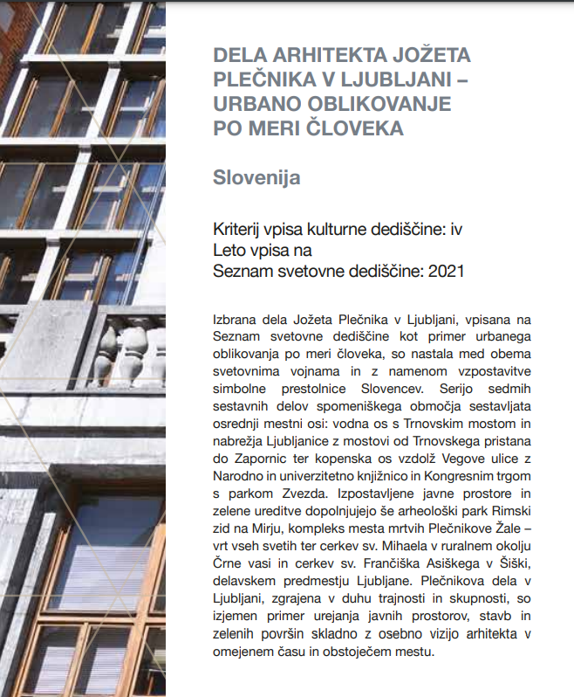

Slide 190
Snovna in Nesnovna kulturna dediščina
Materialna kulturna dediščina« se nanaša na fizične artefakte, ki se proizvajajo, vzdržujejo in prenašajo medgeneracijsko v družbi. Vključuje umetniške stvaritve, gradbeno dediščino, kot so zgradbe in spomeniki, ter druge fizične ali oprijemljive produkte človeške ustvarjalnosti, ki so v družbi vloženi s kulturnim pomenom.

Slide 191
Nesnovna kulturna dediščina
Ohranjanje kulturnega izročila, ki se prenaša v rod, je še posebej pomembno. Nekatere veščine, znanja in ustvarjalnost naših prednikov so tako izjemni, da jih še posebej velja zaščititi in hraniti za prihodnje rodove. Posebno skrb za zaščito in ohranjanje ustnega izročila, plesov, znanj in spretnosti omogoča UNESCO reprezentativni seznam svetovne nesnovne dediščine človeštva. To so dragoceni običaji in navade iz Slovenije, ki so se znašli na reprezentativnem seznamu Unescove nesnovne kulturne dediščine.

Slide 192
‘Nesnovna kulturna dediščina“ označuje „prakse, predstave, izraze, znanje, veščine – kot tudi instrumente, predmete, artefakte in kulturne prostore, povezane z njimi – ki jih skupnosti, skupine in v nekaterih primerih posamezniki priznavajo kot del svoje kulturne dediščine. « (UNESCO, 2003). Primeri nesnovne dediščine so ustna izročila, uprizoritvene umetnosti, lokalno znanje in tradicionalne veščine.

Slide 193
Materialna in nesnovna dediščina zahtevata različne pristope k ohranjanju in varovanju, kar je bil eden od glavnih motivov za zasnovo in ratifikacijo Unescove konvencije o varovanju nesnovne kulturne dediščine iz leta 2003. Konvencija določa soodvisnost med nesnovno kulturno dediščino ter snovno kulturno in naravno dediščino ter priznava vlogo nesnovne kulturne dediščine kot vira kulturne raznolikosti in gonila trajnostnega razvoja.

Slide 194
Čebelarstvo v Sloveniji
Tradicija reje lipicancev
Škofjeloški pasijon
Obhodi kurentov
Klekljanje čipk v Sloveniji
Suhozidna gradnja
Babištvo

Slide 195
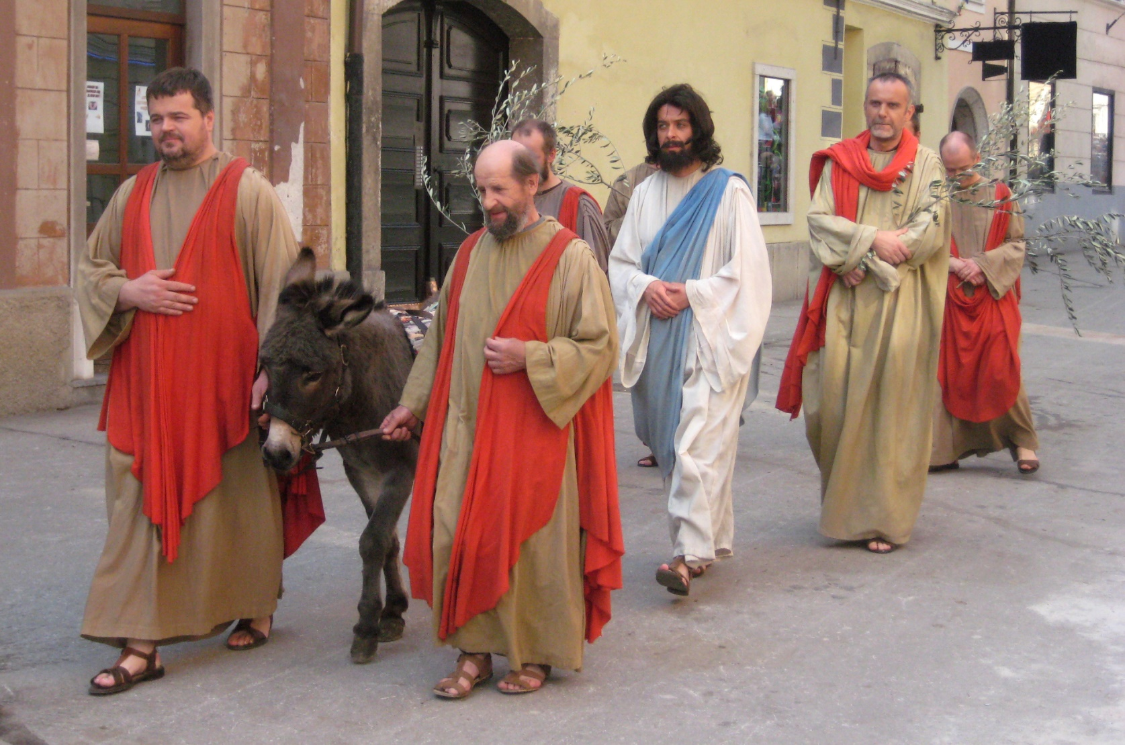
Škofjeloški pasijon

Slide 196
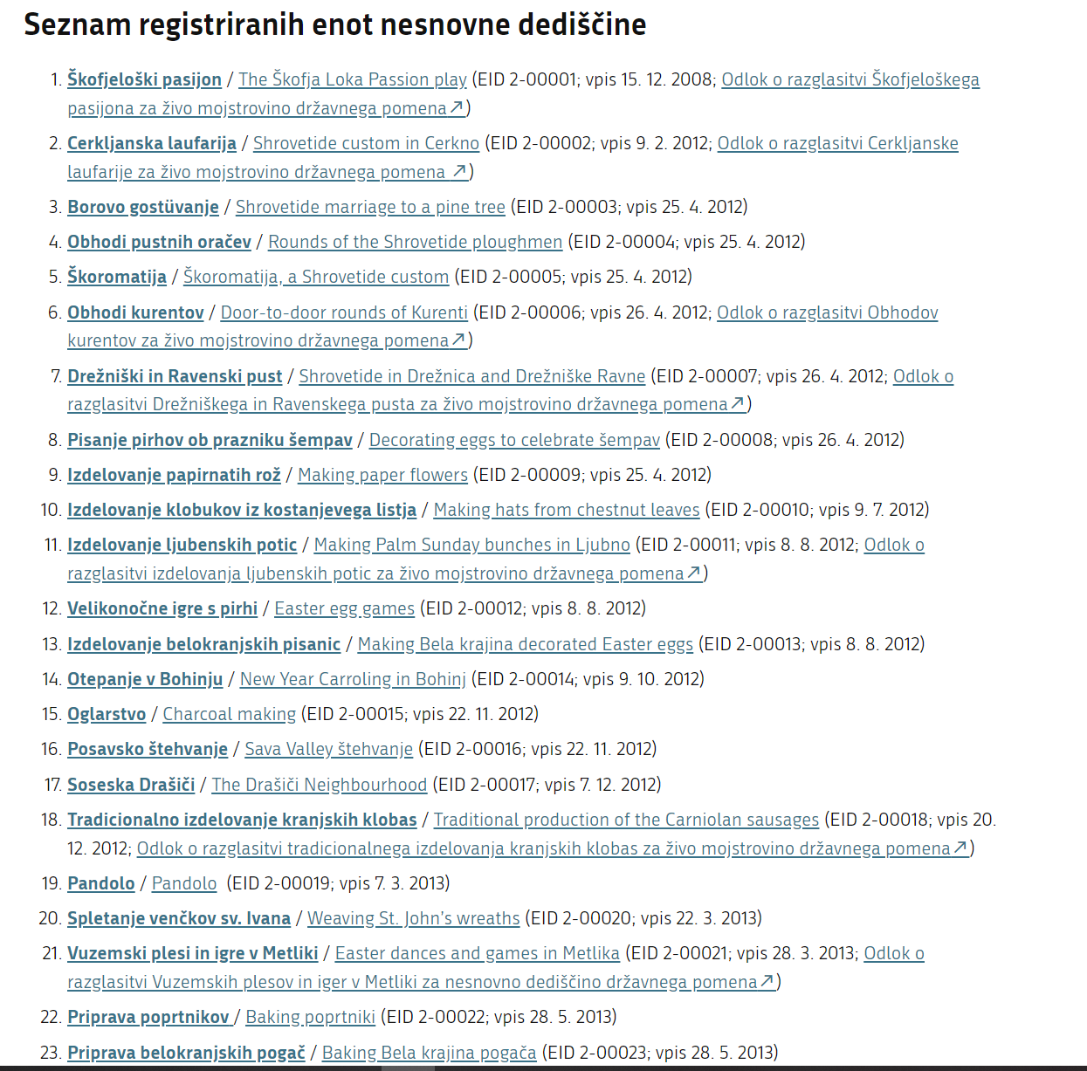

Slide 197



Slide 198

Poskusni Seznam

Slide 199


Slide 204


Slide 205
HUMAN RIGHTS 2.0 & THE EUROPEAN GREEN DEAL
Dr. Mensah cocou marius
SENIOR RESEARCH ASSOCIATE
Faculty OF Law
University of maribor

Slide 206
A Universal Declaration
The 1948 Universal Declaration of Human Rights was drawn up by representatives of many nations to prevent a recurrence of the atrocities of the Second World War and is the cornerstone of modern human rights law.

Slide 207
INTERNATIONAL CODIFICATION
The Universal Declaration is codified in international law through the International Covenant on Civil and Political Rights (ICCPR) and the International Covenant on Economic, Social and Cultural Rights (ICESCR), each of which has been ratified by over 160 States (over three-quarters of all nations). It is recognised that both sets of rights are indivisible and interdependent, and equally important.

Slide 208
BUSINESS & HUMAN RIGHTS
A 2015 survey of The Economist Intelligence Unit found that a majority of business executives now recognise that business is an important player in respecting human rights, and that what their companies do – or fail to do – affects those rights. Business is increasingly recognising the importance of human rights.

Slide 209
Guiding Principles on Business and Human Rights
In 2011 the UN unanimously endorsed the Guiding Principles on Business and Human Rights (the UN Guiding Principles) which sets out the responsibilities business have with regard to human rights. The UN Guiding Principles clarify that the scope of business’ responsibility to respect human rights extends, at a minimum, to those rights expressed in the International Bill of Human Rights and the principles concerning fundamental rights set out in the International Labour Organization’s Declaration on Fundamental Principles and Rights at Work.

Slide 210
WHERE ARE WE GOING?

Slide 211
THE EU GREEN DEAL
The European Green Deal aims primarily to fight against global warming and to offer a strong response to the multiple environmental challenges facing all countries. The consequences of the above activities will have terrible impacts on the European and world economy, at all levels. Already the respiratory diseases due to pollution, the costs of care, and the impact on the standard of living of the populations is clearly indexed. The socio-cultural, political and economic impacts of global warming no longer leave rapid action in doubt.

Slide 212
A STEP FORWARD
It is a step that will promote investments in infrastructure and green energy. The Green Deal will foster in Europe green economy, green technology, sustainable tourism, sustainable industry and transport. By 2050, Europe should be climate neutral and its economy and energy adapted to sustain green development.
The EU green agreement will be binding because it will be incorporated into the first European climate law.

Slide 213
THE CHALLENGE
All EU countries* MUST reach the bar zero greenhouse gas emissions by 2050. In the future, all actions, investments, project financing and European policies will consolidate the European climate law, which will systematically reduce public and even private investments in fossil fuels or polluting technology across the EU. , since 2050 is the target year for achieving these goals.
Notes:
* Except Poland.

Slide 214
EFFECTS
· Rationalize the use of available resources
· Promote circular economy focused on recycling and responsible consumption
· Restore ecosystems and biodiversity by fighting against the depletion of species and reducing pollution.
· Support social justice
· Convert or Adapt all sectors of the economy to finance projects that have a positive impact on the environment
· Invest in environmentally friendly technologies

Slide 215
Support green innovation
· Encourage clean and accessible transportation for all
· Encourage nature-friendly agriculture.
· Assist polluting industries to transfer to more civic and environment-friendly activities- guarantying thus justice and social security.
· Implement the United Nation’s 2030 Agenda and the sustainable development goals

Slide 216
Paul Polman, EX CEO, Unilever
“Business can only flourish in societies in which human rights are respected, upheld and advanced. People are our greatest asset, and empowering them across our supply chain is not only the right thing to do, but also ensures a sustainable future for the business. Our ambition is to embed the promotion of human rights into every function, every role, and every corner of our organization.”

Slide 218
Thank you for your attention

