Slide 1
Natural and Cultural Heritage as a Common Denominator of Integration and Sustainability in the EU
By Dr.
MENSAH C. Marius
Assistant Professor
Faculty of Law- University of Maribor
Cocou.mensah@um.si
2023

Slide 2
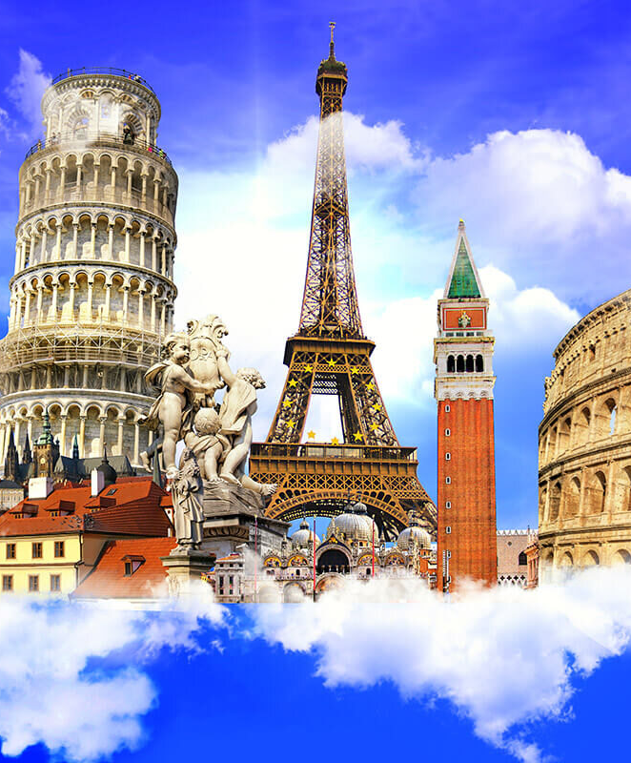
HERITAGE
Heritage is our legacy from the past, what we live with today, and what we pass on to future generations. Our cultural and natural heritage are both irreplaceable sources of life and inspiration. The United Nations Educational, Scientific and Cultural Organization (UNESCO) seeks to encourage the identification, protection and preservation of cultural and natural heritage around the world considered to be of outstanding value to humanity.

Slide 3
Eurostat reported that in 2021, the tourism, natural, and cultural heritage sectors contributed around €756 billion to the European Union, which accounts for approximately 4.9 of the EU’s GDP
This reinforces the EU’s economy and employment rate

Slide 5
Preserving cultural heritage
The event that aroused particular international concern was the decision to build the Aswan High Dam in Egypt, which would have flooded the valley containing the Abu Simbel temples , a treasure of ancient Egyptian civilization. In 1959, after an appeal from the governments of Egypt and Sudan, UNESCO launched an international safeguarding campaign. Archaeological research in the areas to be flooded was accelerated. Above all, the Abu Simbel and Philae temples were dismantled, moved to dry ground and reassembled.

Slide 6
The campaign cost about US$80 million, half of which was donated by some 50 countries, showing the importance of solidarity and nations' shared responsibility in conserving outstanding cultural sites. Its success led to other safeguarding campaigns, such as saving Venice and its Lagoon (Italy) and the Archaeological Ruins at Moenjodaro (Pakistan) , and restoring the Borobodur Temple Compounds (Indonesia).
Consequently, UNESCO initiated, with the help of the International Council on Monuments and Sites (ICOMOS), the preparation of a draft convention on the protection of cultural heritage.

Slide 7
This is embodied in an international treaty called the Convention concerning the Protection of the World Cultural and Natural Heritage, adopted by UNESCO in 1972.
What makes the concept of World Heritage exceptional is its universal application. World Heritage sites belong to all the peoples of the world, irrespective of the territory on which they are located.

Slide 8
UNESCO- MISSION

Slide 10
Strategic Objectives

Slide 11
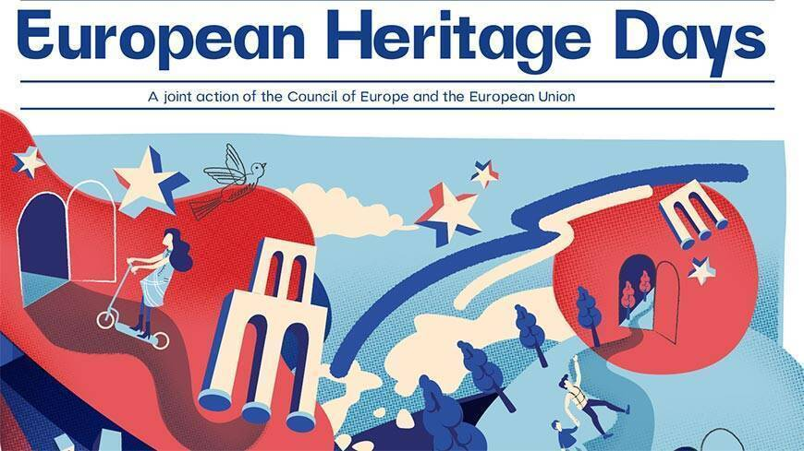
Saturday, September 9- Sunday, September 17
The EU recognizes the importance of preserving and promoting its diverse natural and cultural heritage as a means to foster unity, cooperation, and sustainable development among its member states.

Slide 12
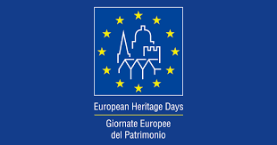
The European Heritage Days represent the most extensively commemorated cultural event in Europe that encourages active participation among its people. Initiated by the Council of Europe in 1985, the program gained the involvement of the European Union in 1999, and it has persisted ever since. Remarkably, this joint initiative attracts an impressive annual visitor count of up to 20 million, making it the most economically impactful cultural undertaking in Europe when considering the value generated for every Euro invested.

Slide 13
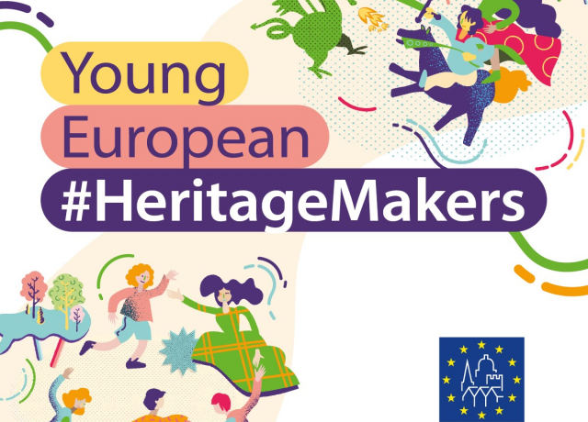
Young European #HeritageMakers
The Young European Heritage Makers is a contest designed for the youth of Europe, offering them a platform to delve into their surroundings, discover the most captivating aspects of their heritage, and showcase them to a global audience. This competition aims to inspire young individuals to grasp the significance of heritage and articulate their perspectives effectively.

Slide 14
Countries participating
Entries are open to two age categories – age 6-11 and age 11-17 .
Finland
Montenegro
North Macedonia
Slovenia
Spain
Ukraine

Slide 15
EU Legal Regulations
European Convention on the Protection of the Archaeological Heritage (revised) - This convention, also known as the Valletta Convention, was adopted in 1992 and aims to protect Europe's archaeological heritage.
Convention for the Protection of the Architectural Heritage of Europe - This convention, also known as the Granada Convention, was adopted in 1985 and aims to protect Europe's architectural heritage.
European Landscape Convention - This convention was adopted in 2000 and aims to protect, manage and plan European landscapes.

Slide 16
European Convention on the Protection of Audiovisual Heritage - This convention was adopted in 2001 and aims to protect Europe's audiovisual heritage.
European Charter for the Protection of Human Rights and Fundamental Freedoms - This charter, also known as the European Convention on Human Rights, was adopted in 1950 and includes provisions protecting cultural and natural heritage.
In addition to these conventions and charters, there are also various EU regulations and directives that relate to cultural and natural heritage, such as the EU Directive on the Conservation of Natural Habitats and of Wild Fauna and Flora (also known as the Habitats Directive) and the EU Directive on the Conservation of Wild Birds.

Slide 17
The EU GREEN DEAL: Europe the first carbon-neutral continent by 2050. By 2030, the plan would decrease European Union greenhouse gas (GHG) emissions by at least 50 percent compared with 1990 levels. The previous, already controversial target was 40 percent.
The New European Bauhaus: The New European Bauhaus is a creative and interdisciplinary initiative that connects the European Green Deal to our living spaces and experiences. Enriching, inspired by art and culture, responding to needs beyond functionality.
Sustainable, in harmony with nature, the environment, and our planet.
Inclusive, encouraging a dialogue across cultures, disciplines, genders and ages.
The European Cultural Heritage Green Paper "Putting Europe's shared heritage at the heart of the European Green Deal".
Eurostat reported that in 2021, the tourism, natural, and cultural heritage sectors contributed around €756 billion to the European Union (EU) GDP, which accounts for approximately 4.9% of the EU's GDP.

Slide 19
In conclusion, natural and cultural heritage act as a common denominator of integration and sustainability in the EU by promoting cultural exchange, supporting economic development, fostering environmental stewardship, enhancing education and awareness, and providing funding and policy support. By valuing and preserving its diverse heritage, the EU strengthens its unity and sustainability, while promoting a shared sense of identity among its member states.

Slide 24
Tangible and intangible Cultural Heritage
Tangible Cultural Heritage’ refers to physical artefacts produced, maintained and transmitted intergenerationally in a society. It includes artistic creations, built heritage such as buildings and monuments, and other physical or tangible products of human creativity that are invested with cultural significance in a society.

Slide 25
‘Intangible Cultural Heritage’ indicates ‘the practices, representations, expressions, knowledge, skills – as well as the instruments, objects, artefacts and cultural spaces associated therewith – that communities, groups and, in some cases, individuals recognize as part of their Cultural Heritage’ (UNESCO, 2003). Examples of intangible heritage are oral traditions, performing arts, local knowledge, and traditional skills.

Slide 26
Tangible and intangible heritage require different approaches for preservation and safeguarding, which has been one of the main motivations driving the conception and ratification of the 2003 UNESCO Convention for the Safeguarding of the Intangible Cultural Heritage. The Convention stipulates the interdependence between intangible Cultural Heritage, and tangible cultural and natural heritage, and acknowledges the role of intangible Cultural Heritage as a source of cultural diversity and a driver of sustainable development.

Slide 27
Recognizing the value of people for the expression and transmission of intangible Cultural Heritage, UNESCO spearheaded the recognition and promotion of living human treasures, ‘persons who possess to a very high degree the knowledge and skills required for performing or recreating specific elements of the intangible Cultural Heritage’.

Slide 30
THANK YOU

