Slide 1
The Rule of Law and the Sustainable Development Goals
By Dr.
MENSAH C. Marius
Assistant Professor
Faculty of Law- University of Maribor
Cocou.mensah@um.si
2024

Slide 2
The SDGs
Adopted in January 2016, they represent the new, post-2015 development agenda: a set of 17 goals with 169 targets and further indicators to be pursued by every UN member state until 2030. One of the most significant developments is Goal 16 (peace, justice and strong governance) and nestled under this goal, target 16.3, which emphasises the promotion of the rule of law at national and international levels.

Slide 4
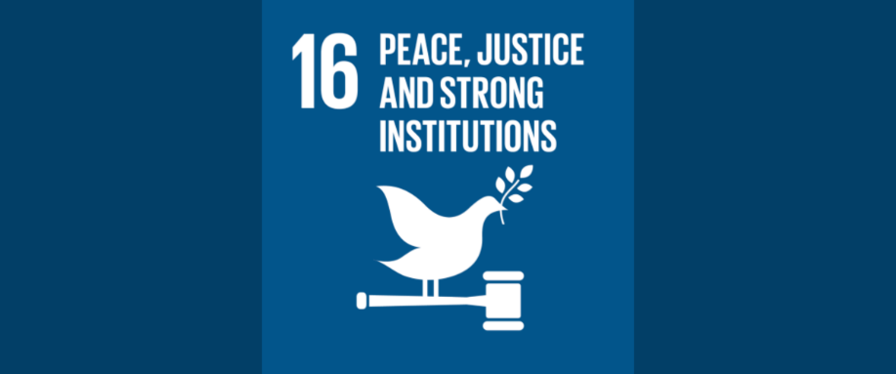
The Right to a Sustainable Planet
Respect for human rights: The law must respect and protect human rights, including the right to a fair trial, freedom of speech and association, and the right to private property.
The rule of law is a fundamental principle of democratic societies, and it is essential for ensuring good governance, protecting human rights, and promoting economic and social development.

Slide 5
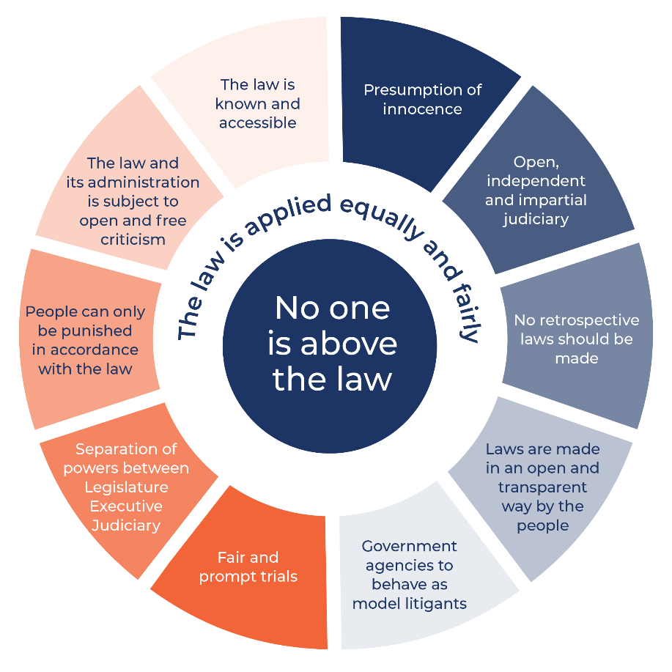
The Rule of Law
The rule of law is a legal concept that refers to the principle that every person, organization, and institution is subject to the law, and that the law must be applied fairly, consistently, and impartially to everyone. The rule of law requires that all individuals and institutions, including government officials and institutions, are bound by and accountable to the law, and that the laws are clear, predictable, and applied without discrimination or arbitrary judgment.

Slide 6
Key legal sources that describe the rule of law
Code of Hammurabi (1754 BC):
The Code of Hammurabi is a set of 282 laws that were inscribed on a black stone pillar in ancient Babylon in 1754 BC. It is one of the oldest surviving legal codes in the world and provides a fascinating glimpse into the legal system of ancient Mesopotamia.
Key principles of the Code of Hammurabi:
Legal equality: The Code of Hammurabi proclaimed that all citizens, regardless of their social status, were subject to the law. This principle was a major step towards establishing a more just and equitable society.
Fairness and impartiality: The Code of Hammurabi required judges to apply the law fairly and impartially, and it prohibited them from taking bribes or showing favoritism.
Retributive justice: The Code of Hammurabi prescribed harsh punishments for certain crimes, such as death or mutilation. However, it also recognized the principle of proportionality, and punishments were generally tailored to the severity of the crime.

Slide 7
Key legal sources that describe the rule of law
Magna Carta (1215): This landmark document is often considered to be a foundational principle of the rule of law. It established the principle that the King was subject to the law and that no person could be arbitrarily imprisoned or deprived of their property without due process. The Magna Carta is a set of 63 clauses agreed to by King John of England and a group of rebel barons in 1215. It is considered to be one of the most important documents in English history and has had a profound impact on the development of the rule of law around the world.

Slide 8
International Covenant on Civil and Political Rights (1966): This international treaty, adopted by the United Nations General Assembly, outlines a number of civil and political rights that are essential for the rule of law. These rights include the right to life, the right to freedom from torture, and the right to a fair trial.
Rome Statute of the International Criminal Court (1998): This international treaty established the International Criminal Court (ICC), which is responsible for investigating and prosecuting individuals accused of the most serious crimes of international concern, including genocide, crimes against humanity, and war crimes. The Rome Statute explicitly recognizes the importance of the rule of law in the context of international criminal justice.

Slide 9
Key legal sources that describe the rule of law
United Nations Charter (1945): The UN Charter, the founding document of the United Nations, explicitly recognises the rule of law as a fundamental principle of international law. Article 2(1) of the Charter states that the UN is based on the principle of the "rule of law.“
UN General Assembly Resolutions:
UN General Assembly Resolution 217 (III) A (1948): This resolution, adopted by the UN General Assembly, affirmed the Universal Declaration of Human Rights, which includes a number of provisions that are essential for the rule of law.
UN Commission on Human Rights Resolution 2000/65 (2000): This resolution called for the strengthening of the rule of law at the national, regional, and international levels.
UN General Assembly Resolution 64/142 (2009): This resolution adopted the Basic Principles on the Rule of Law, which provide a comprehensive framework for understanding and promoting the rule of law.
UN General Assembly Resolution 72/127 (2017): This resolution reaffirmed the importance of the rule of law for achieving sustainable development and peace.

Slide 10
Climate Change
The Intergovernmental Panel on Climate Change (IPCC) has warned that global temperatures could reach or even exceed 1.5 degrees Celsius above pre-industrial levels as early as the next decade unless urgent action is taken to reduce emissions.
To limit global warming to 1.5 degrees Celsius, the world needs to achieve net-zero emissions by around mid-century.
This requires a rapid and deep transformation of the global economy, including phasing out fossil fuels, increasing renewable energy, and implementing energy-efficient technologies. It also requires significant changes in land use, agriculture, and other sectors.
Meeting the 1.5-degree threshold will require unprecedented efforts, but it is crucial to avoid the worst impacts of climate change, such as more frequent and severe heatwaves, droughts, floods, and other extreme weather events, and to protect the planet for future generations.
Governments must adopt policies and regulations that drive the transition to a low-carbon economy and provide financial support for clean energy and climate adaptation. Businesses must reduce their carbon footprint and invest in sustainable technologies and practices. Individuals can reduce their own carbon footprint by making lifestyle changes such as using public transportation, reducing meat consumption, and using energy-efficient appliances.

Slide 12
Countries and islands that are at risk of disappearing due to global warming and climate change
Maldives: The Maldives, an island nation in the Indian Ocean, is one of the most vulnerable countries to sea-level rise. Some projections suggest that the country could be entirely submerged by the end of the century.
1
Marshall Islands: The Marshall Islands, a Pacific island nation, is also highly vulnerable to sea-level rise. The government has already begun planning for the possibility of relocating its entire population to other countries.
2
Tuvalu: Tuvalu, a small island nation in the Pacific, is facing the threat of inundation from rising sea levels. The government has already begun exploring options for relocation.
3
Kiribati: Kiribati, another Pacific island nation, is also highly vulnerable to sea-level rise. The government has purchased land in Fiji as a possible relocation site for its population.
4
Bangladesh: Bangladesh is a low-lying country that is at high risk of flooding and sea-level rise. The country's large population and limited resources make it particularly vulnerable to the impacts of climate change.
5

Slide 13
Pollution facts in the EU
Air pollution: Air pollution is a major problem in the EU, causing an estimated 400,000 premature deaths each year. The main sources of air pollution are transportation, industry, and households. Eastern European countries, such as Poland and Bulgaria, tend to have higher levels of air pollution compared to Western European countries.
Water pollution: Water pollution is also a significant problem in the EU, with agricultural runoff, sewage, and industrial waste being major contributors. This pollution can lead to harmful algal blooms, fish kills, and other ecological impacts.
Waste management: The EU generates around 2.5 billion tons of waste each year, with only about 40% of this waste being recycled or composted. The rest ends up in landfills, where it can contribute to air and water pollution.
Energy consumption: The EU is a major consumer of energy, with the majority of its energy needs being met by fossil fuels. This contributes to greenhouse gas emissions, which contribute to climate change and air pollution.

Slide 14
The Solution
Advocate for stronger laws and policies: Individuals, organizations, and advocacy groups can put pressure on lawmakers to adopt and enforce stronger laws and policies that promote sustainable development. This can be done through lobbying, public campaigns, and other forms of activism.
Use the legal system: Individuals and groups can use the legal system to challenge government decisions that violate environmental laws and regulations. This can include filing lawsuits, engaging in administrative proceedings, and other legal actions.
Increase public awareness: Raising public awareness about sustainable development and the need for stronger laws and regulations can help create a groundswell of support for change. This can be done through education campaigns, social media, and other forms of public engagement.

Slide 15
Promote international cooperation: Sustainable development is a global issue, and international cooperation is essential to address it. Governments, businesses, and civil society organizations can work together to share knowledge, resources, and best practices, and to promote sustainable development goals at the international level.
Promote transparency and accountability: Governments can be held accountable for their actions through transparency and accountability measures such as public reporting, independent monitoring, and citizen participation in decision-making.

Slide 16
THANK YOU

