Slide 1
Protecting Cultural Heritage in the era of digitalization
Docent
MENSAH C. Marius
Pravna fakulteta Univerze v Mariboru
Cocou.mensah@um.si

Slide 2
HERITAGE
Heritage is our treasure from the past, what we live with today and what we pass on to future generations. Our cultural and natural heritage are irreplaceable sources of life and inspiration. The United Nations Educational, Scientific and Cultural Organization (UNESCO) works to promote the identification, protection, and conservation of cultural and natural heritage around the world, which is considered to be of outstanding value to humanity.

Slide 3
This is embodied in an international treaty called the Convention concerning the Protection of the World Cultural and Natural Heritage, adopted by UNESCO in 1972.
The concept of World Heritage is remarkable for its universal application. World heritage sites belong to all nations of the world, regardless of the territory on which they are located.

Slide 5
Preservation of cultural heritage
An event that caused particular international concern was the decision to build the Aswan High Dam in Egypt, which would flood the valley containing the Abu Simbel temples, a treasure of ancient Egyptian civilization. In 1959, at the request of the governments of Egypt and Sudan, UNESCO launched an international protection campaign. Archaeological research in the flooded areas was accelerated. Most notably, the temples of Abu Simbel and Philae were dismantled, moved to dry ground and reassembled.

Slide 6
The campaign cost about 80 million US dollars, half of which was contributed by around 50 countries, which shows the importance of solidarity and joint responsibility of nations in preserving outstanding cultural sites. Its success led to other protective actions, such as the rescue of Venice and its lagoon (Italy) and the archaeological ruins in Moenjodar (Pakistan) and the restoration of the temple complexes of Borobodur (Indonesia). As a result, UNESCO, with the help of the International Council on Monuments and Sites (ICOMOS) started the preparation of a draft convention on the protection of cultural heritage.

Slide 13
Tangible and Intangible cultural heritage
Tangible cultural heritage' refers to physical artefacts that are produced, maintained and transmitted intergenerationally in society. It includes artistic creations, built heritage such as buildings and monuments, and other physical or tangible products of human creativity that are invested with cultural significance in society.

Slide 14
‘Intangible cultural heritage' refers to 'practices, performances, expressions, knowledge, skills - as well as instruments, objects, artefacts and cultural spaces associated with them - which communities, groups and in some cases individuals recognize as part of their cultural heritage. " (UNESCO, 2003). Examples of intangible heritage are oral traditions, performing arts, local knowledge and traditional skills.

Slide 15
Škofjeloški pasijon

Slide 16
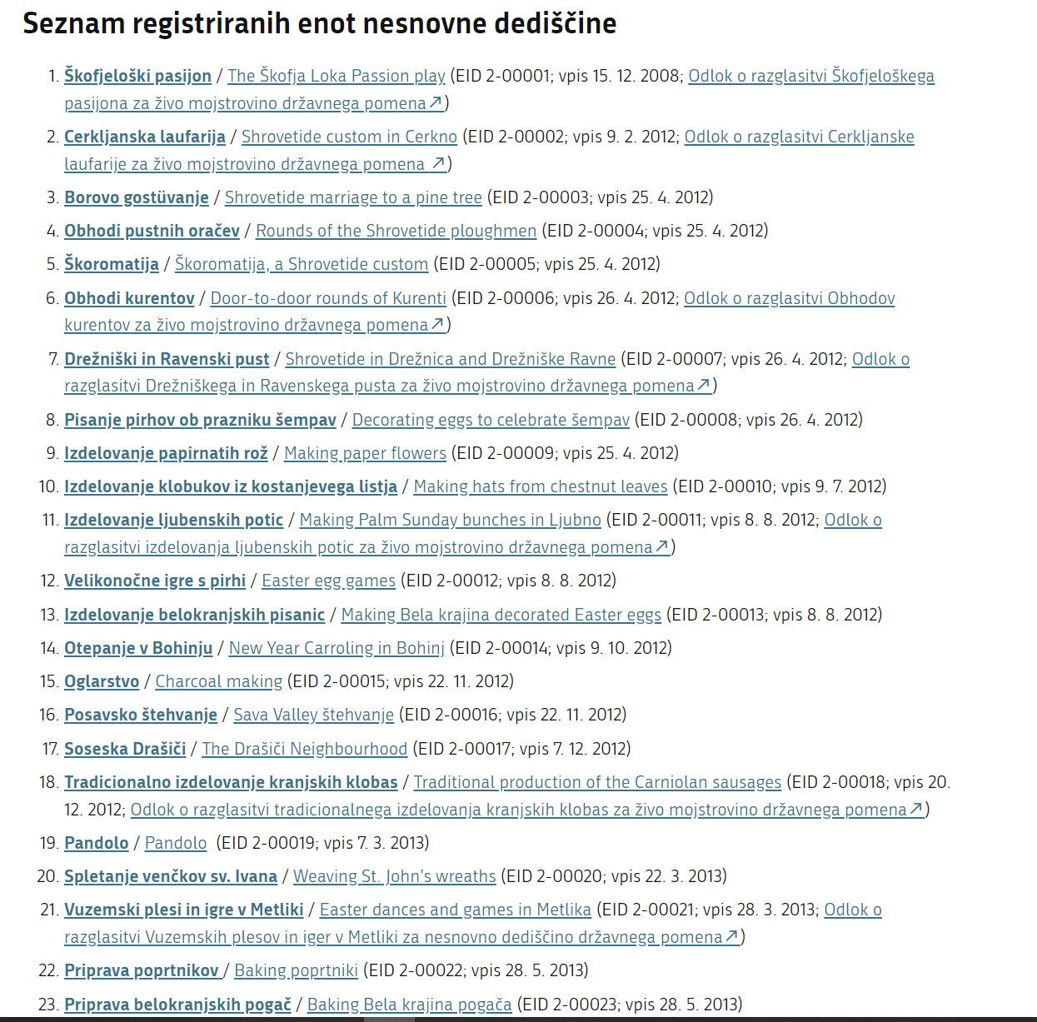

Slide 17
MISIJA UNESCO

Slide 19
Strategic Objectives

